Slide 1
 | Age (yrs) | Gender | Education (yrs) | MoCA
Younger Adults (n=31) | 23.65 (2.86) | 54.80% female (n=17) | 15.90 (2.27) | N/A
Older Adults (n=27) | 73.44 (7.06) | 51.90% female (n=14) | 15.30 (3.69) | 28.11 (1.01)
Data from first 8 blocks used consistently across block and trial-level analyses.

Slide 2
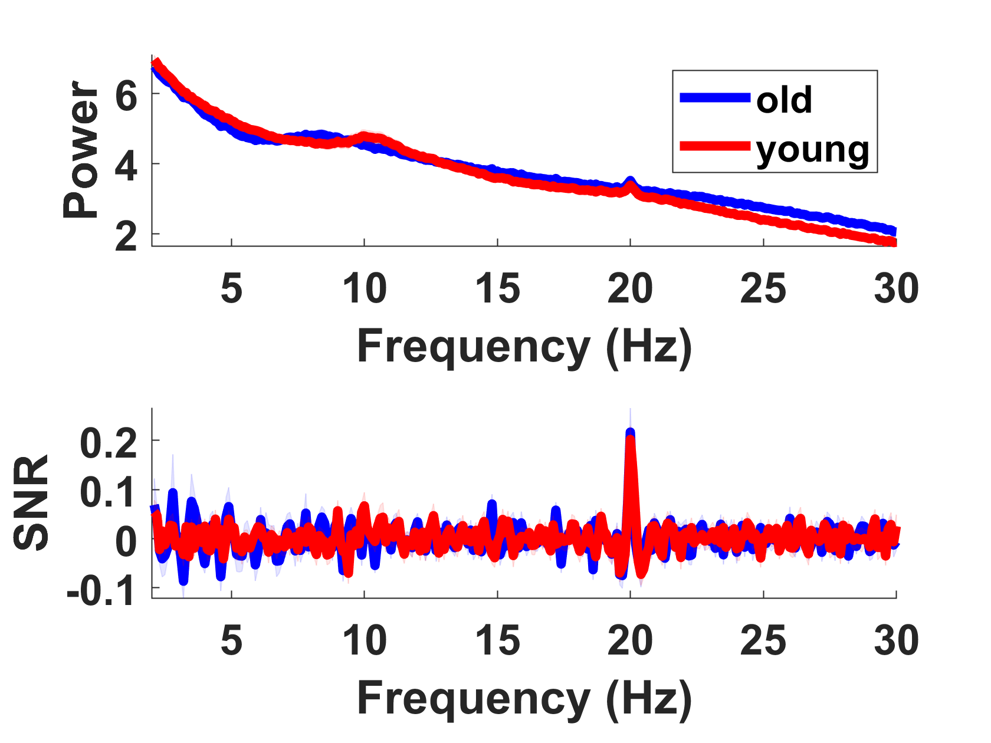
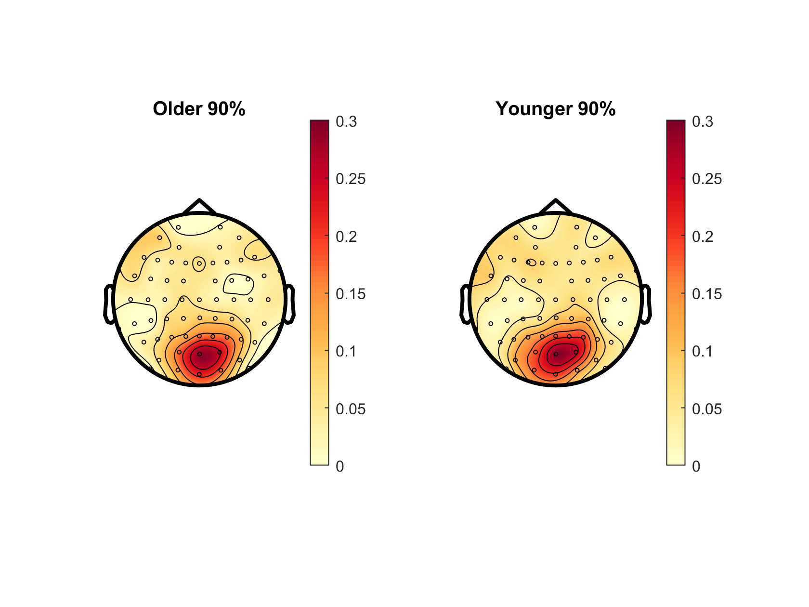
Notes:
? Slightly different to Oz PSD in plotPowerSpec script

Slide 3
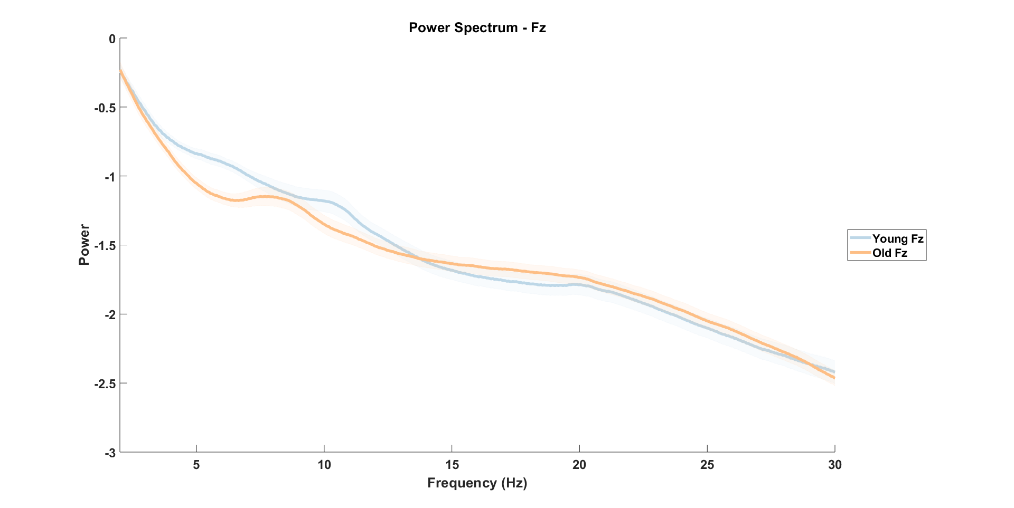

Slide 4
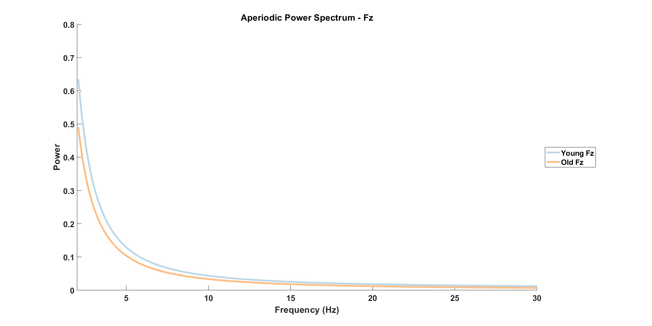

Slide 5
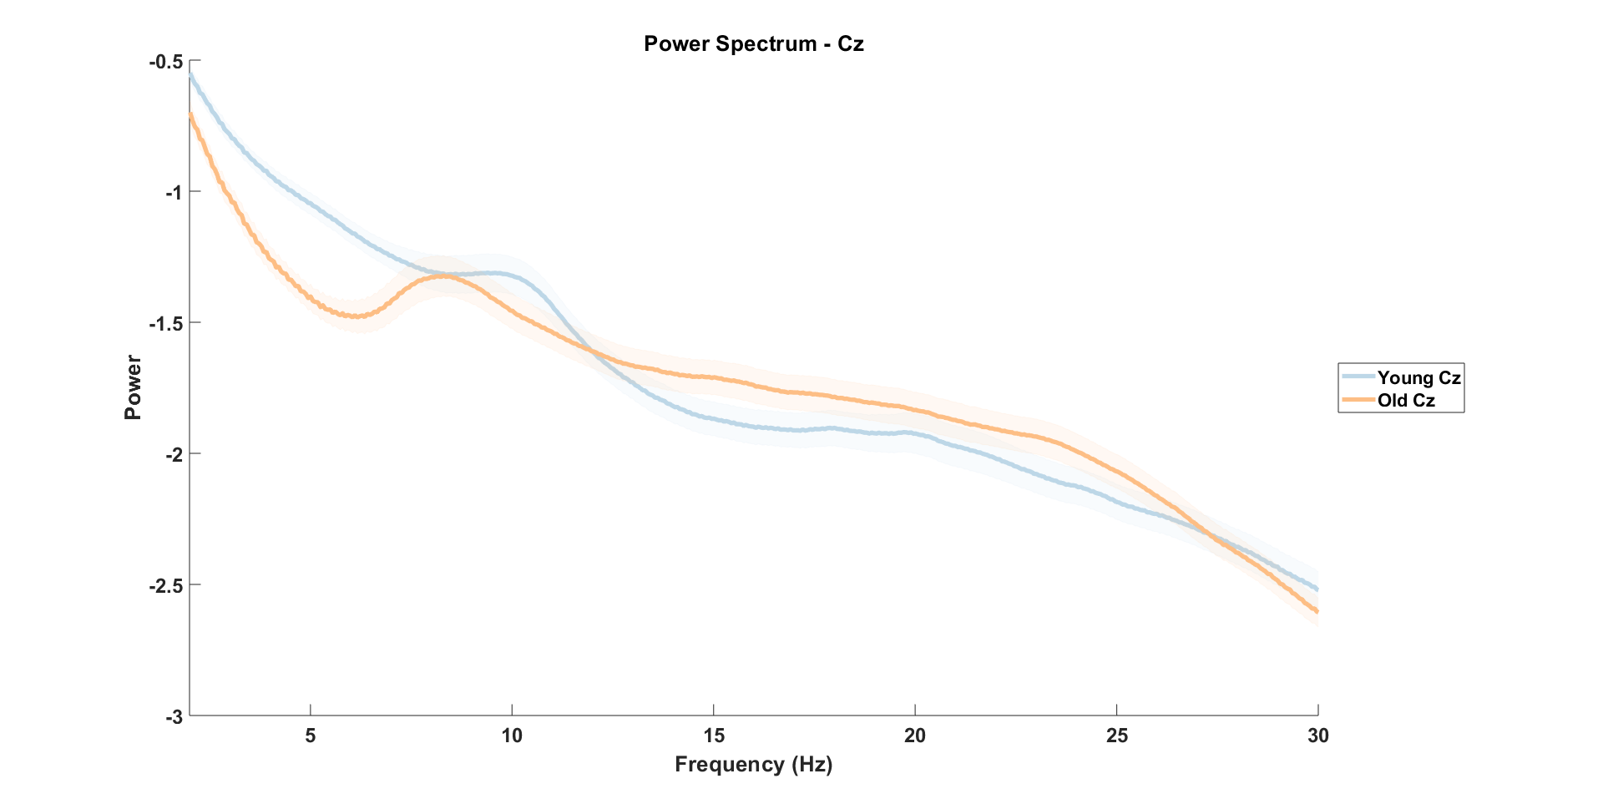

Slide 6
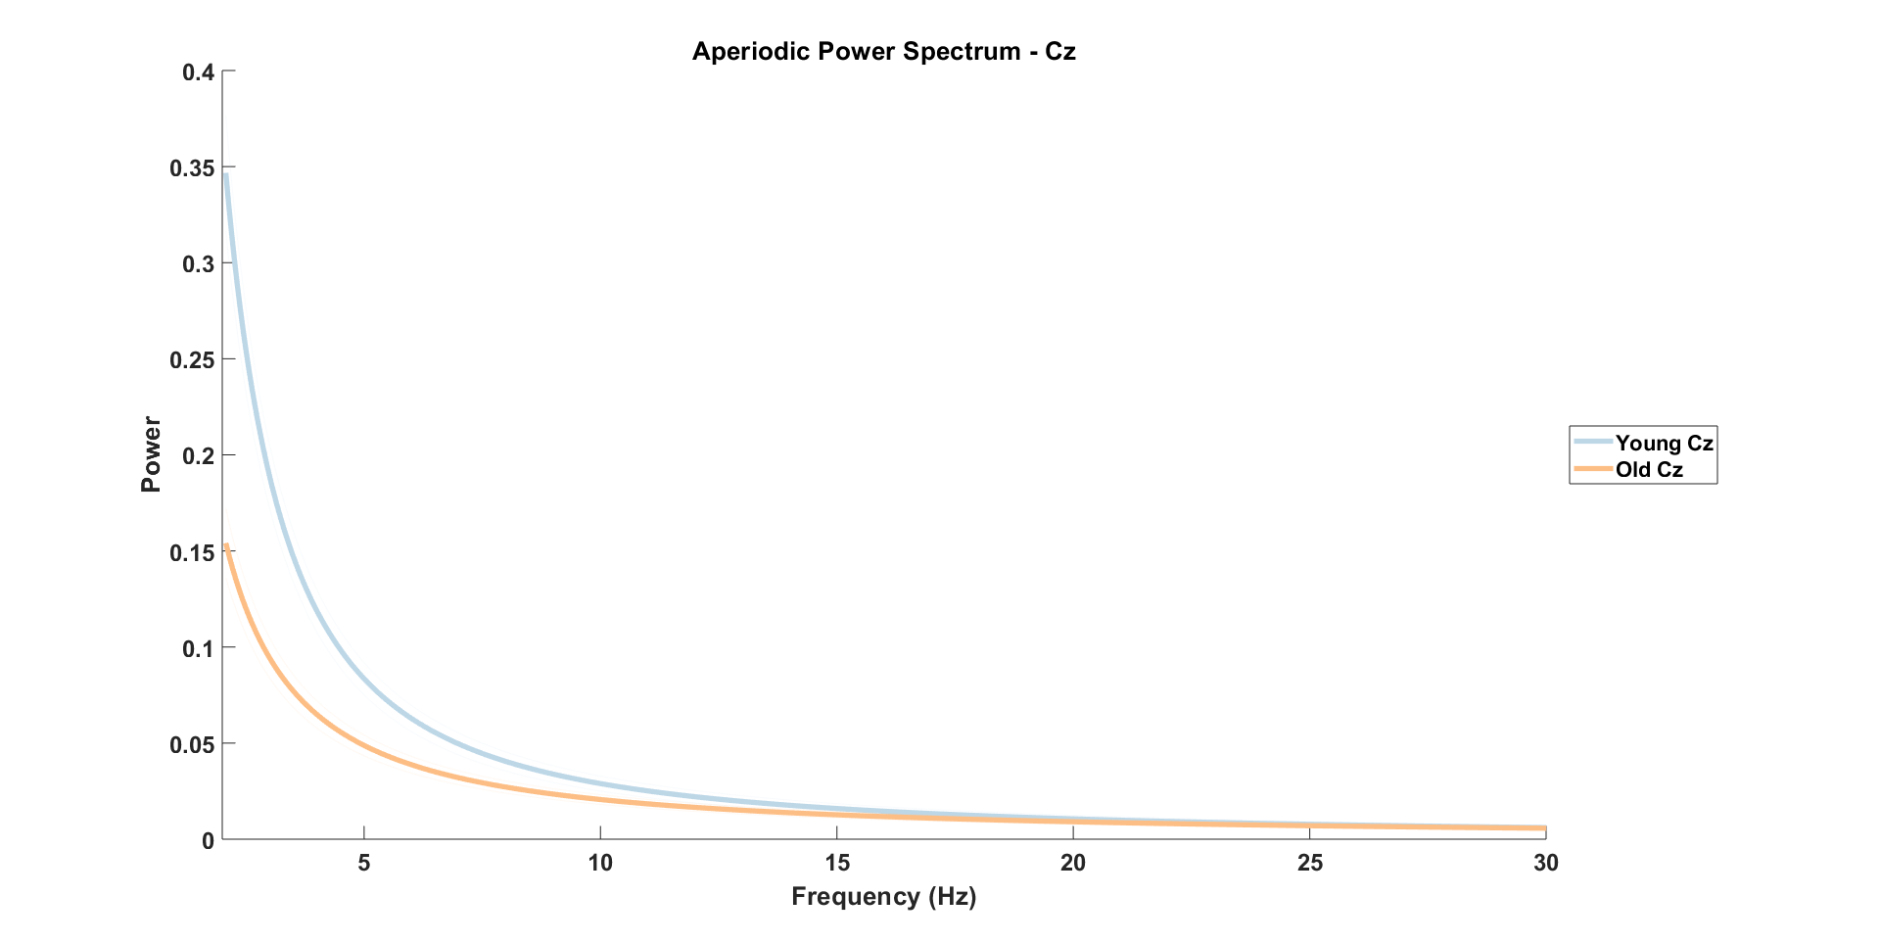

Slide 7
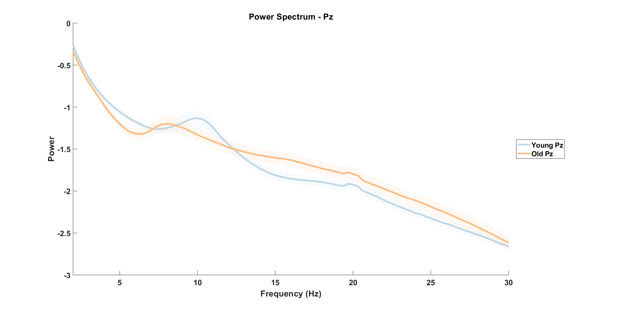

Slide 8
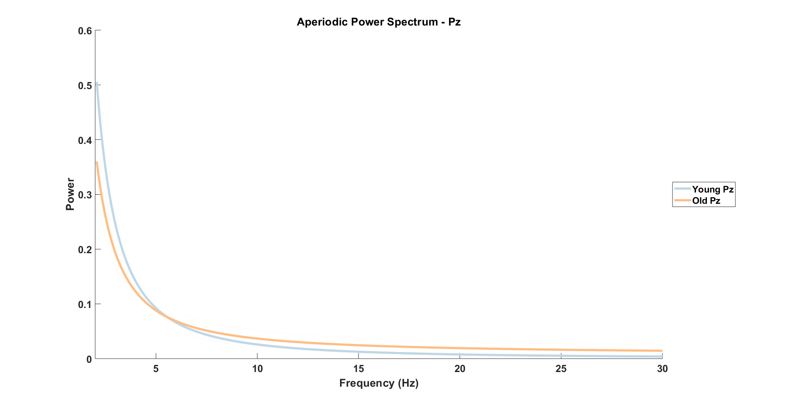

Slide 9
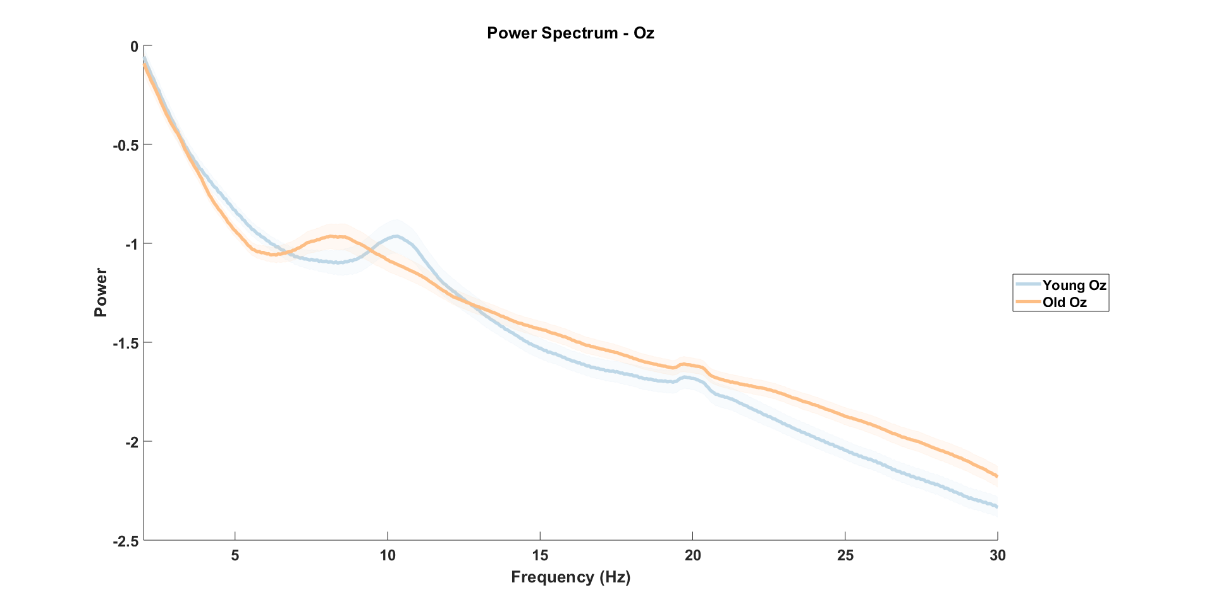

Slide 10
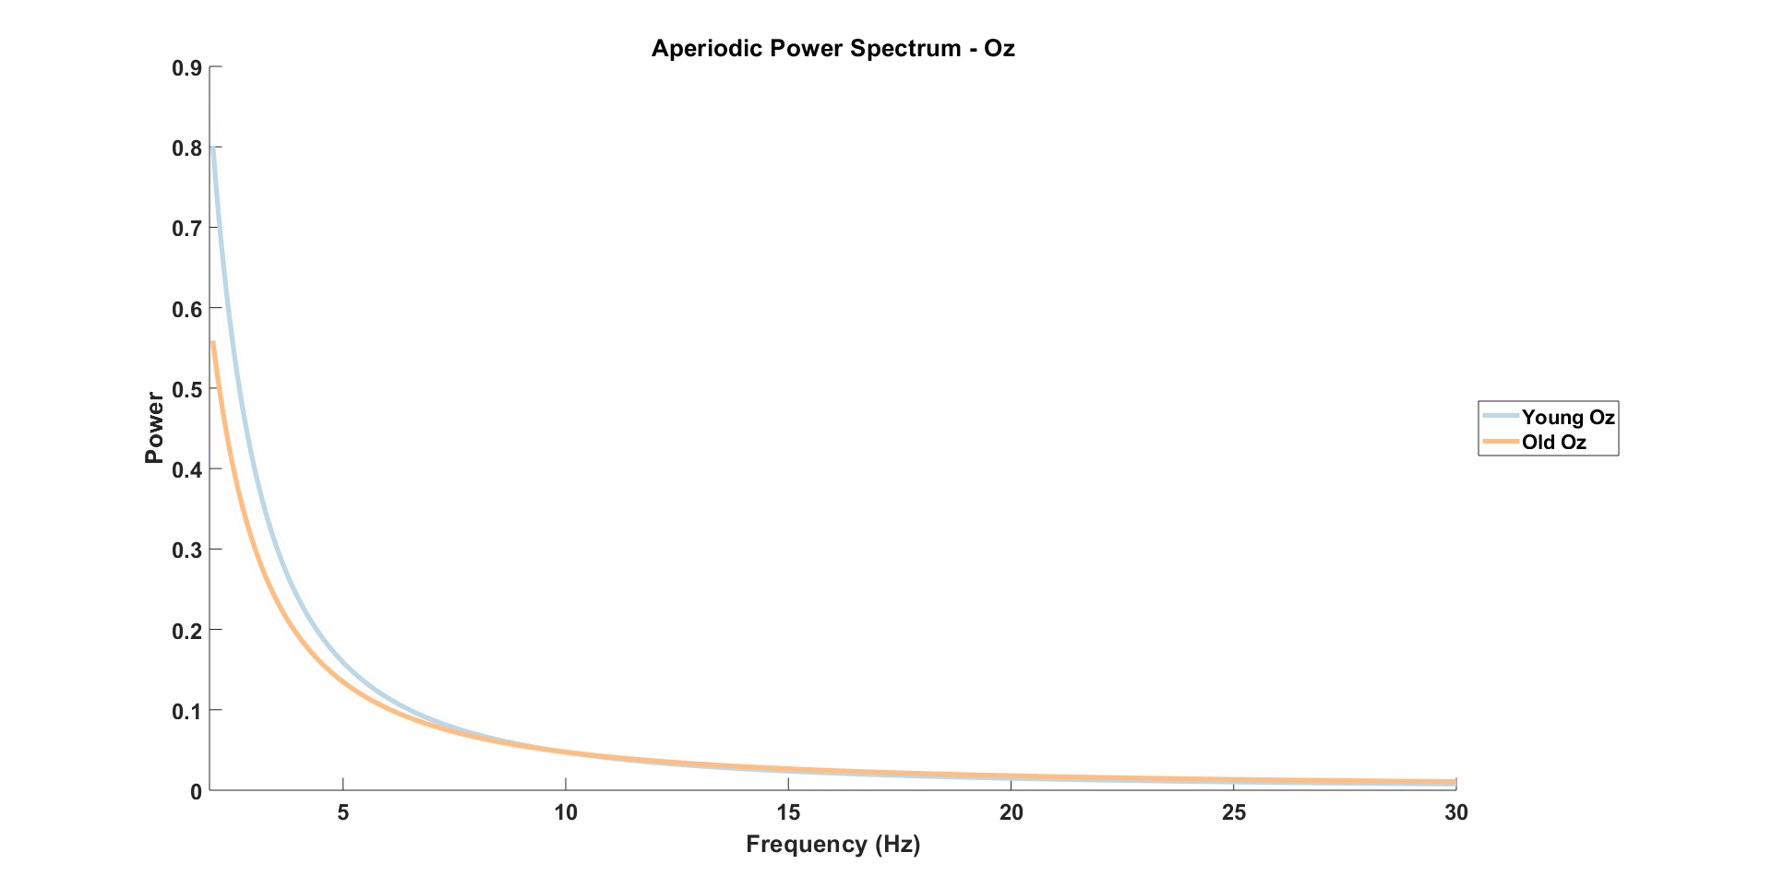

Slide 11
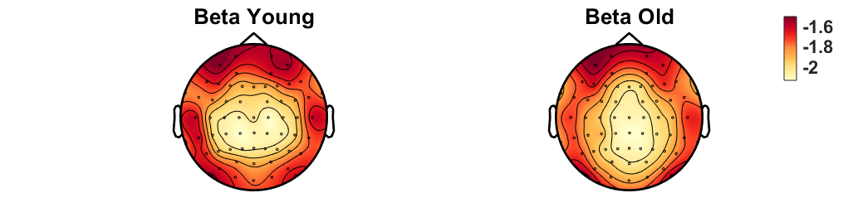
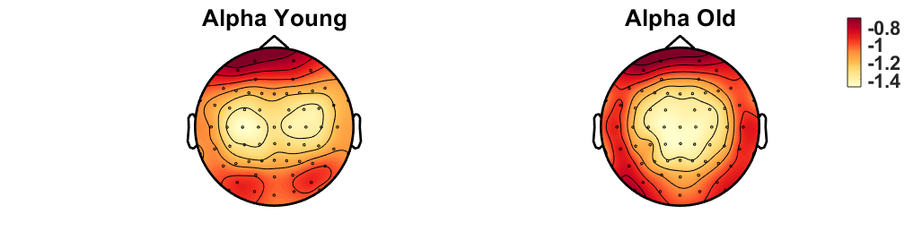
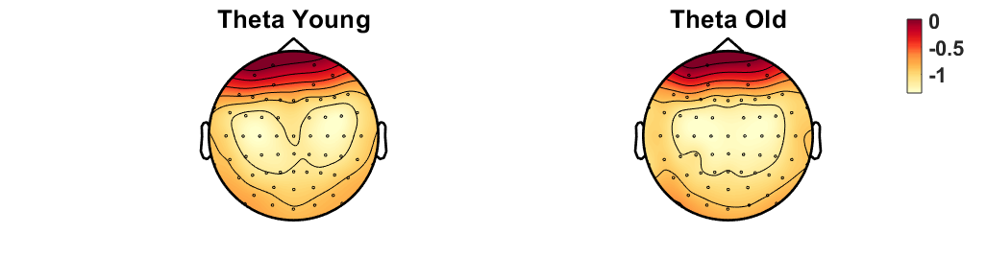
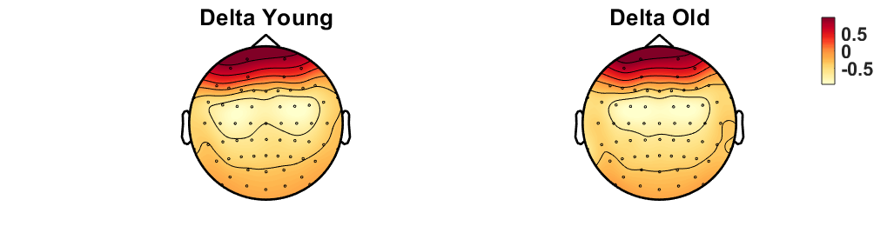
Notes:
REPLICATE TOPOGRAPHIES with all_osci (new scripts)
+ differences old-young for each freq band

Slide 12
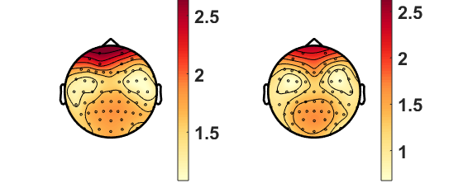
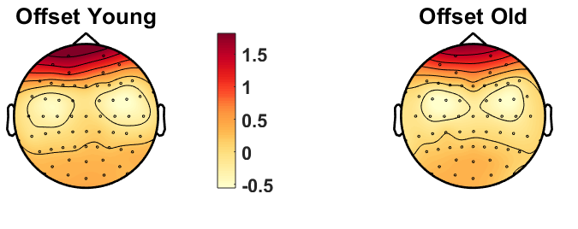
Aperiodic Slope – Younger 90% vs Older 90%
Aperiodic Offset – Younger 90% vs Older 90%
Notes:
Add old-young difference topograpjy

Slide 13
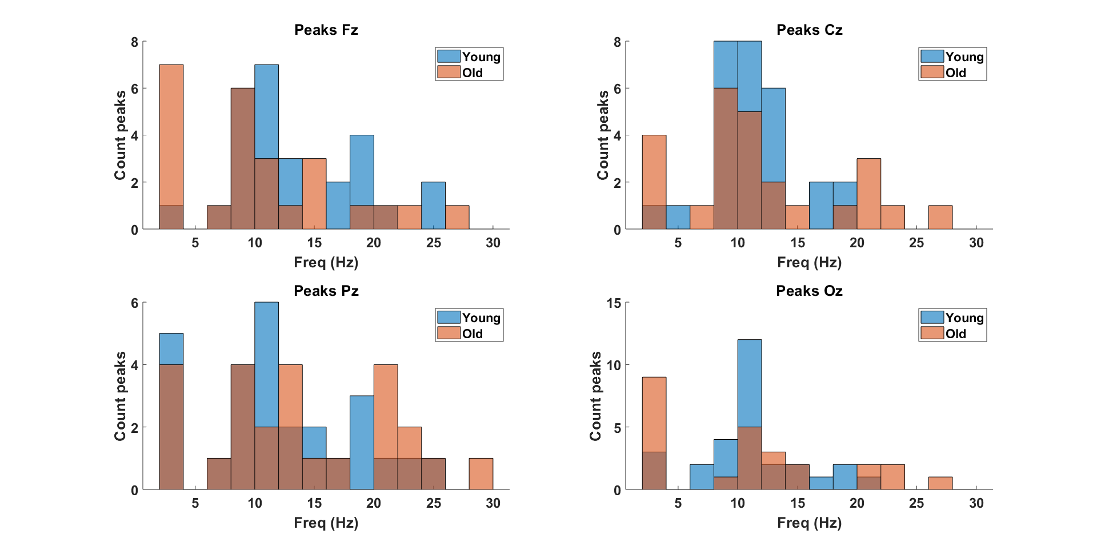

Slide 14
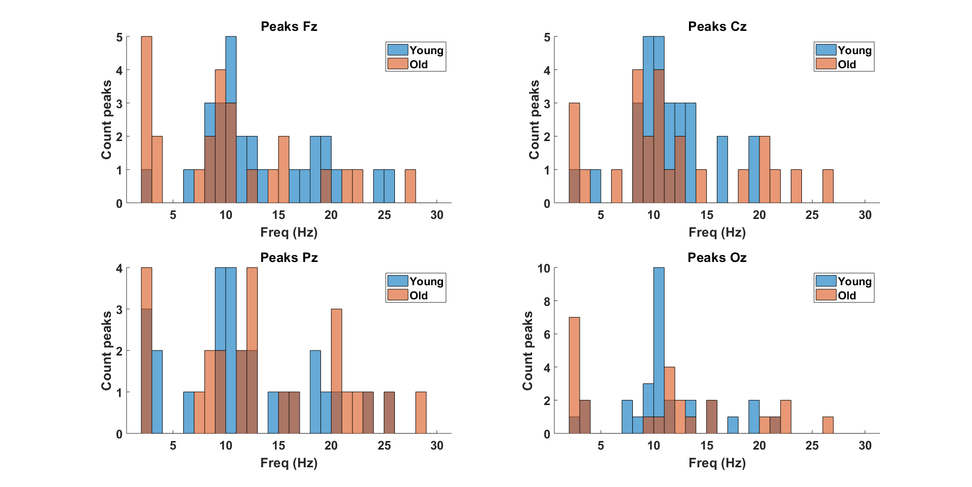
Notes:
Proportion of individuals with a peak in the alpha range and the theta/delta range (see all_detectedpeaks variable)

Slide 15
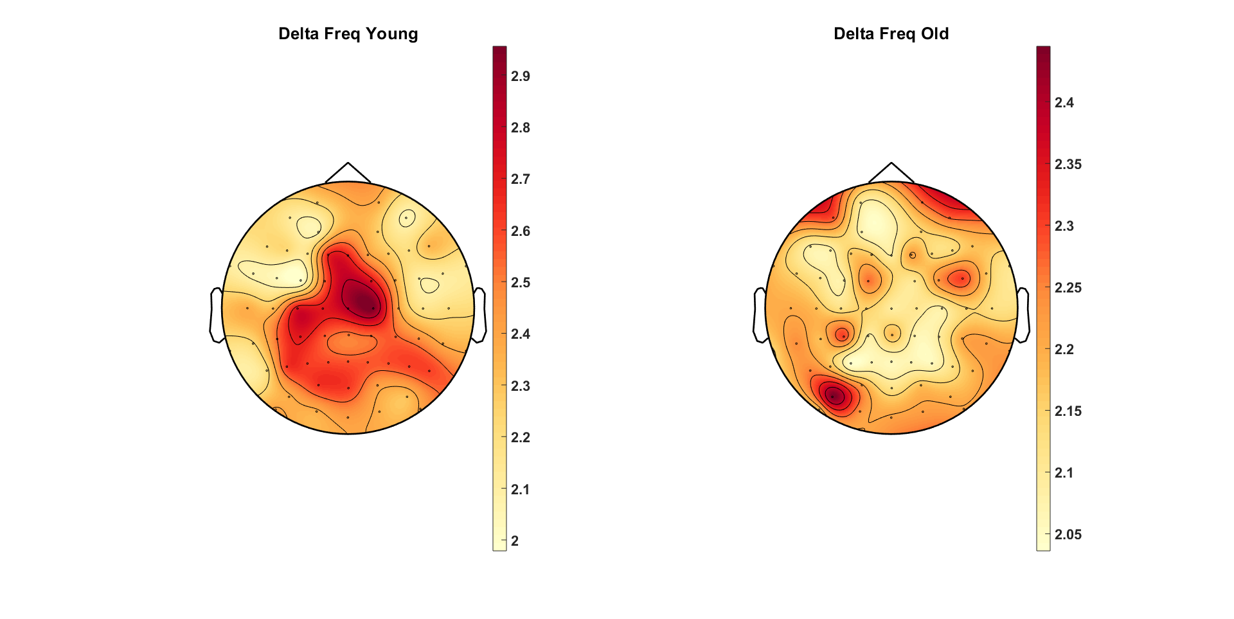
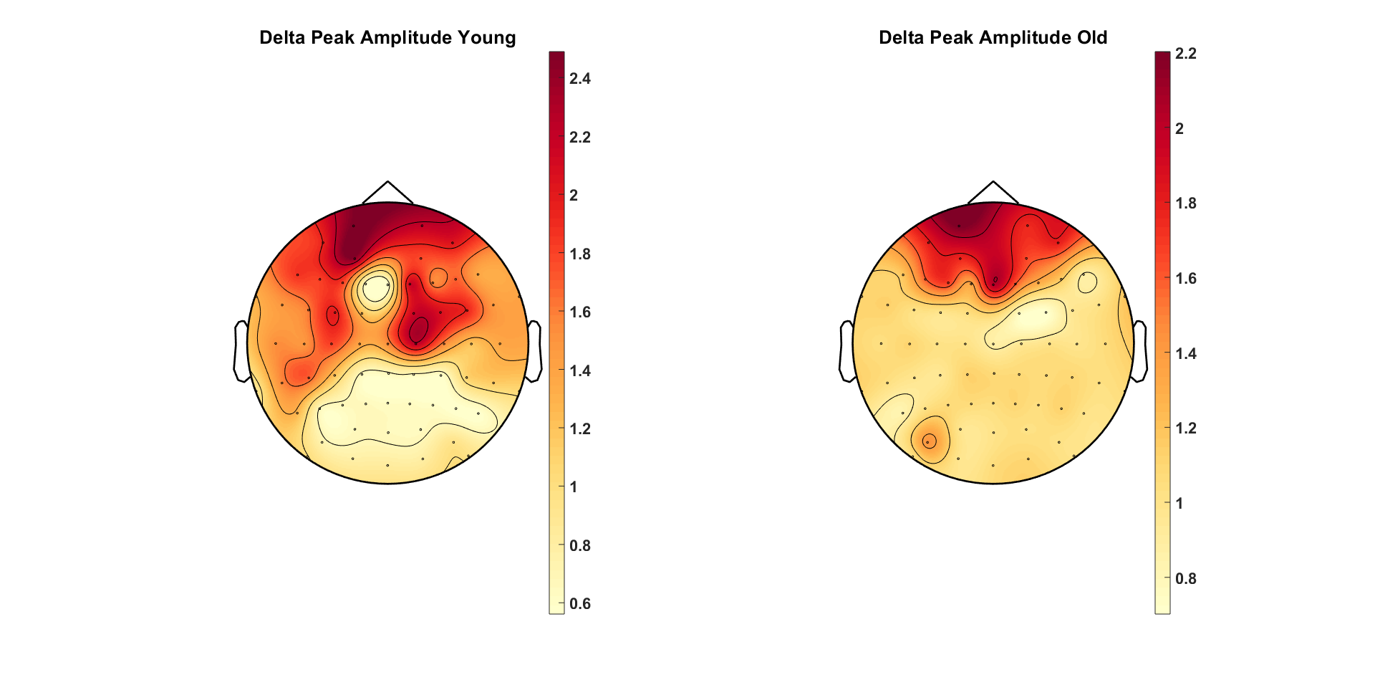
Delta Peak Frequency – Younger 90% vs Older 90%
Delta Peak Amplitude – Younger 90% vs Older 90%
Notes:
Same scale if possible

Slide 16
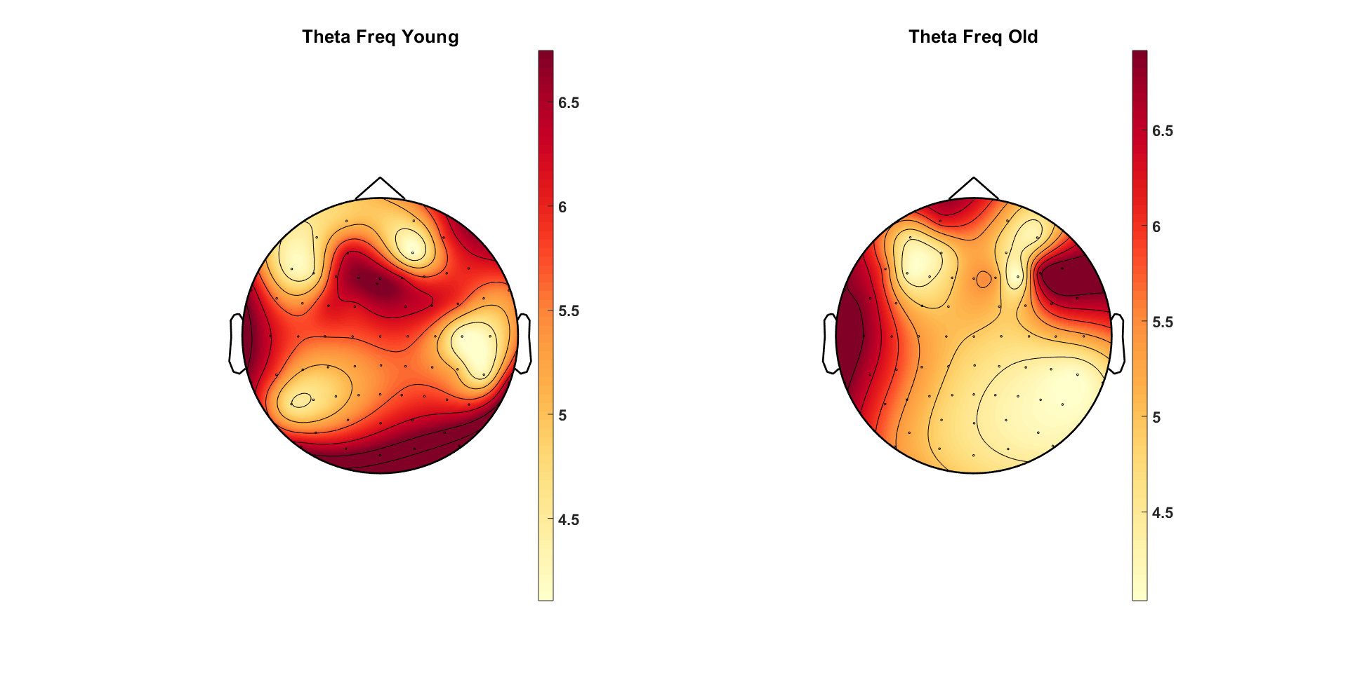
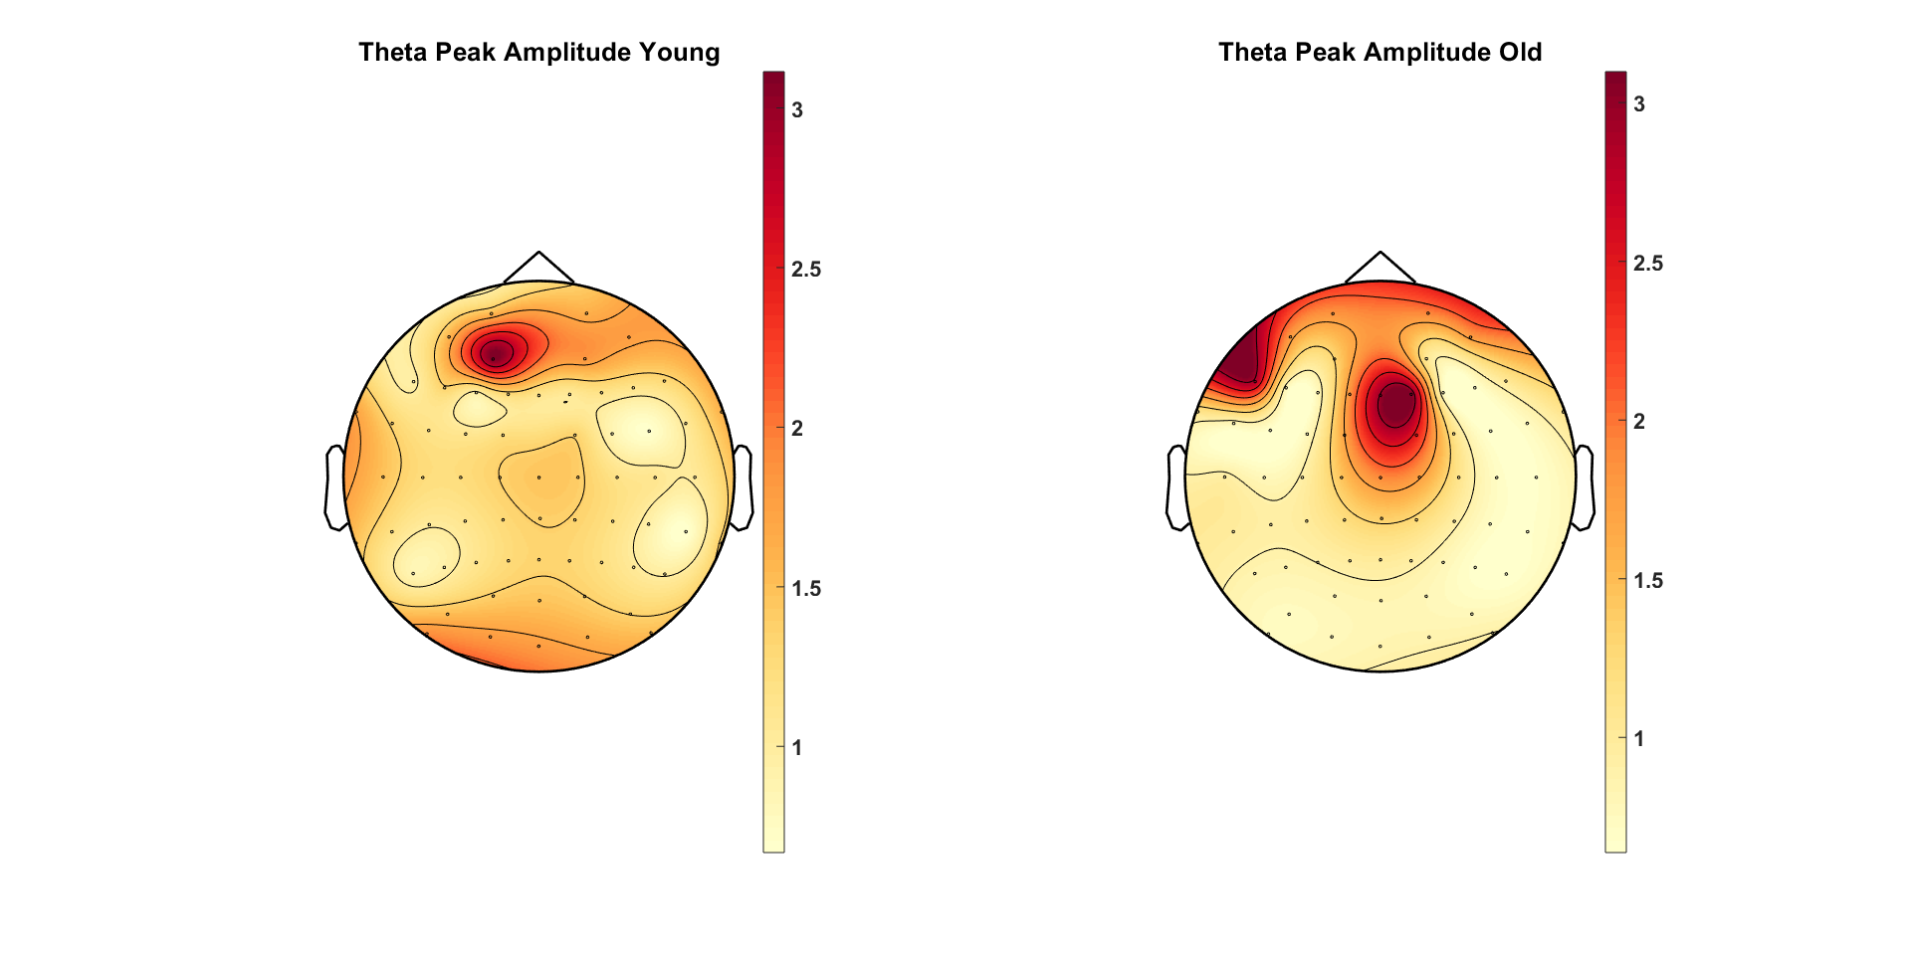
Theta Peak Frequency – Younger 90% vs Older 90%
Theta Peak Amplitude – Younger 90% vs Older 90%
Notes:
Pull delta and theta together

Slide 17
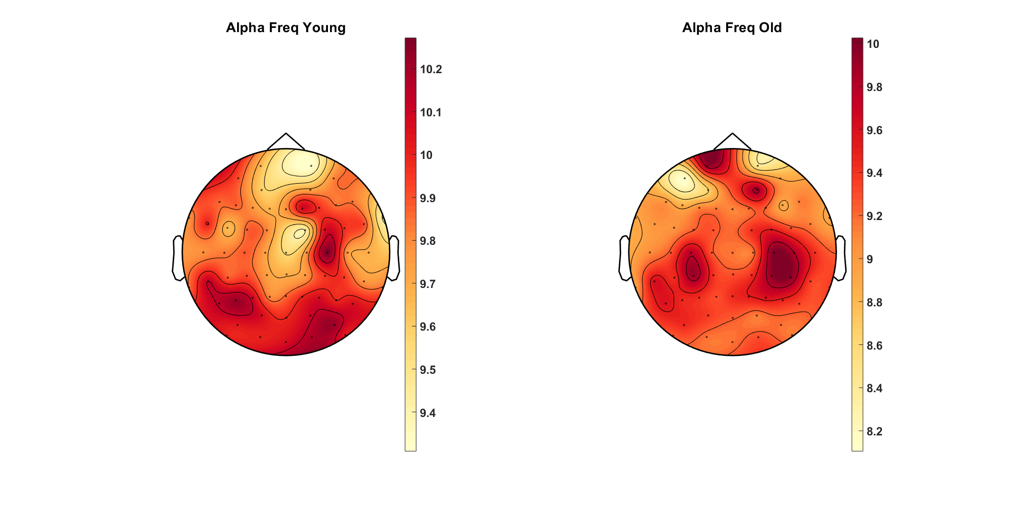
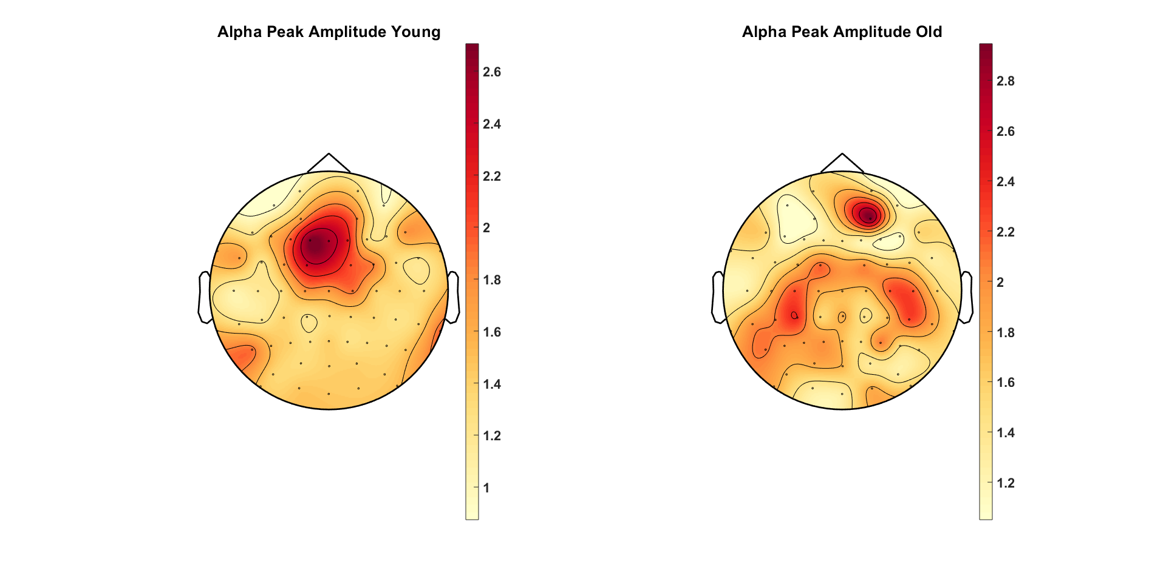
Alpha Peak Frequency – Younger 90% vs Older 90%
Alpha Peak Amplitude – Younger 90% vs Older 90%

Slide 18
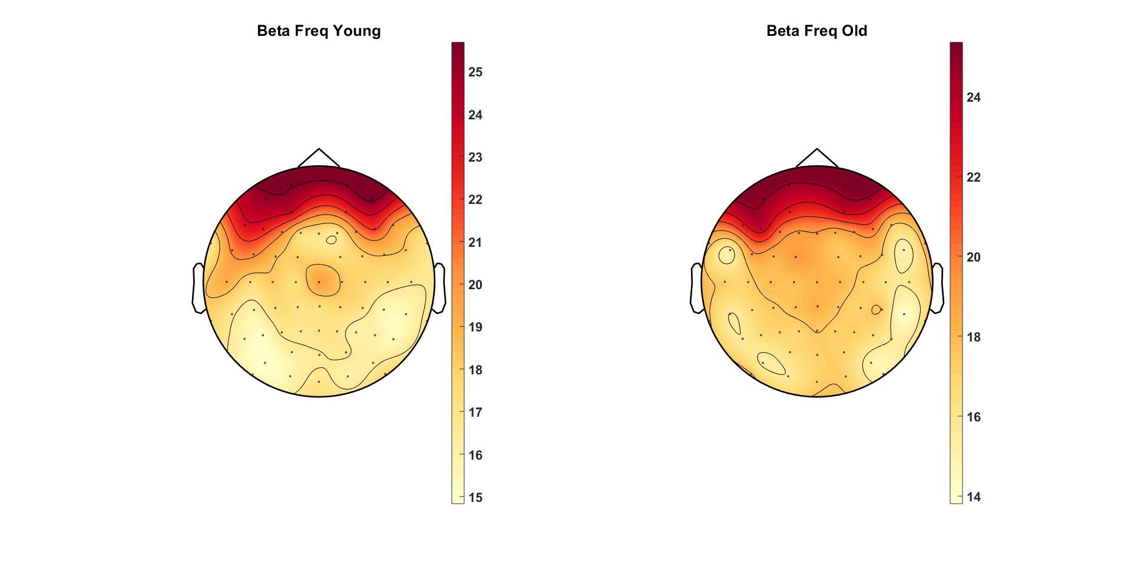
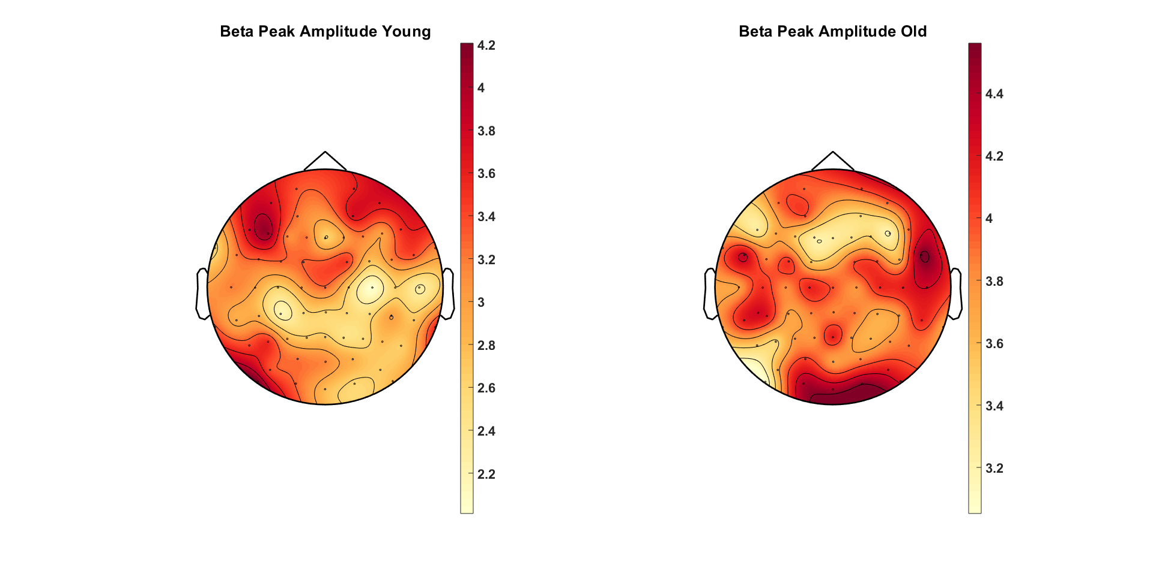
Beta Peak Frequency – Younger 90% vs Older 90%
Beta Peak Amplitude – Younger 90% vs Older 90%

Slide 19
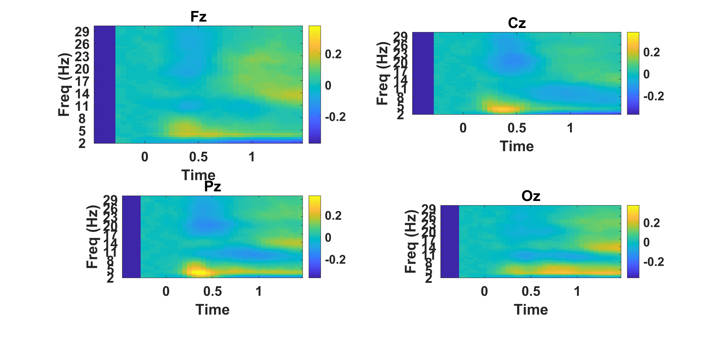
Young 90% Coherence

Slide 20
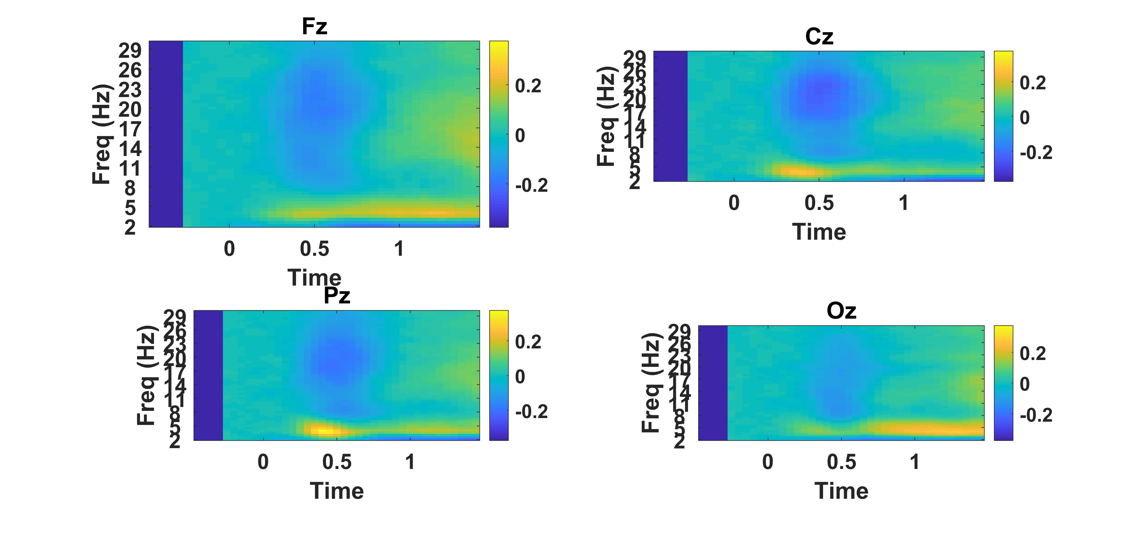
Old 90% Coherence

Slide 21
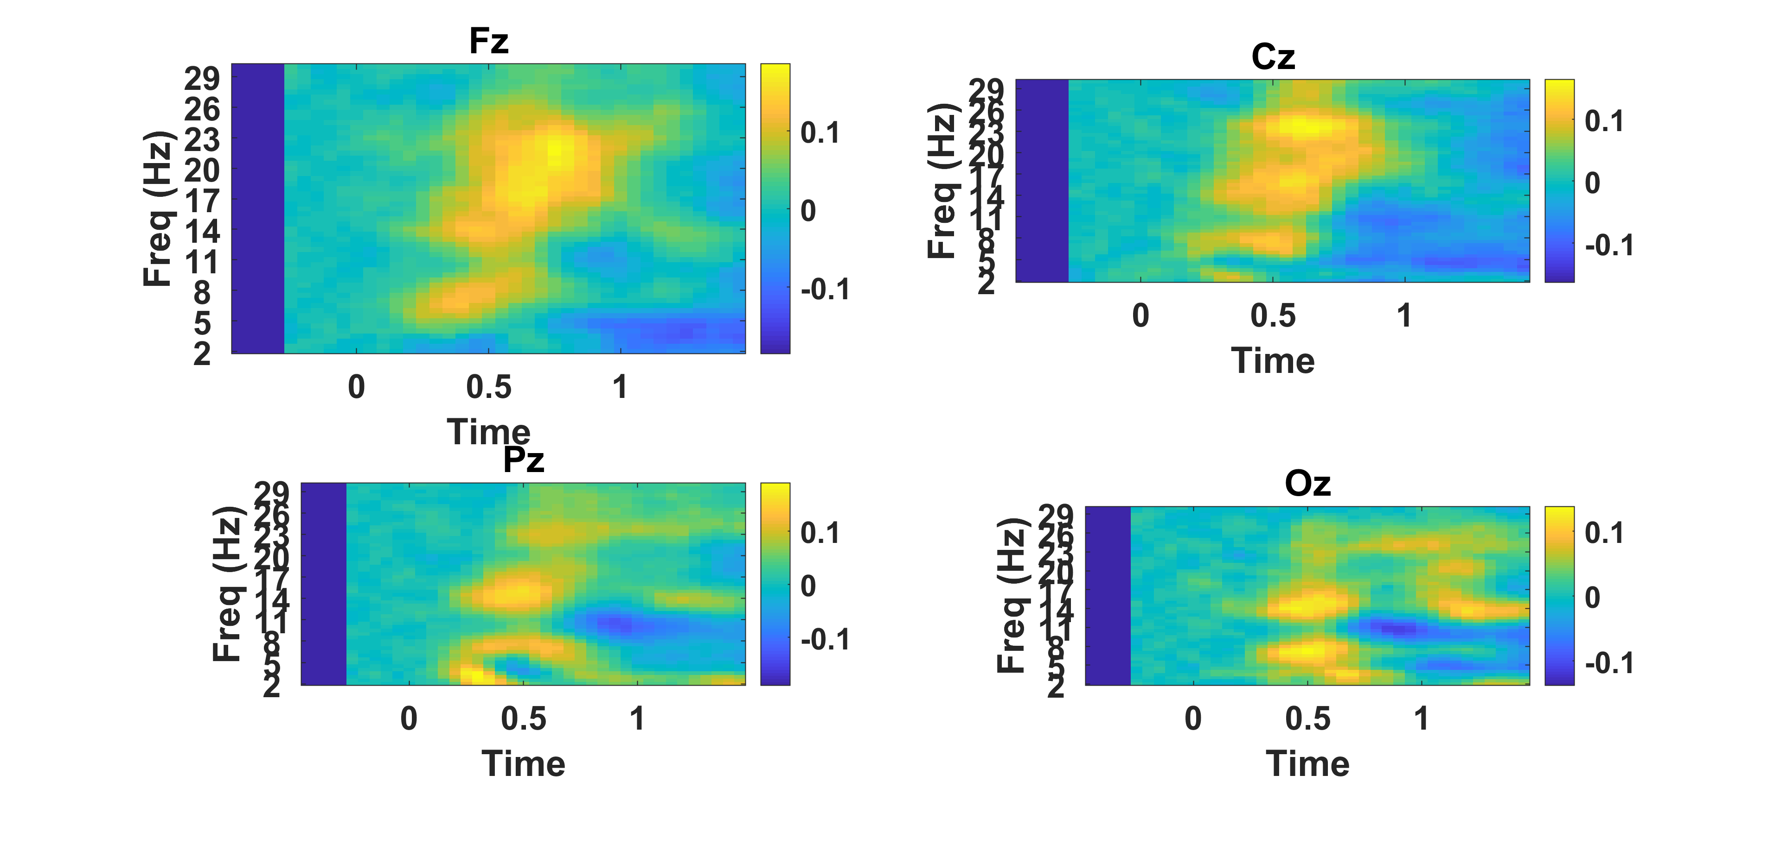
Difference TF – Young-Old

Slide 22
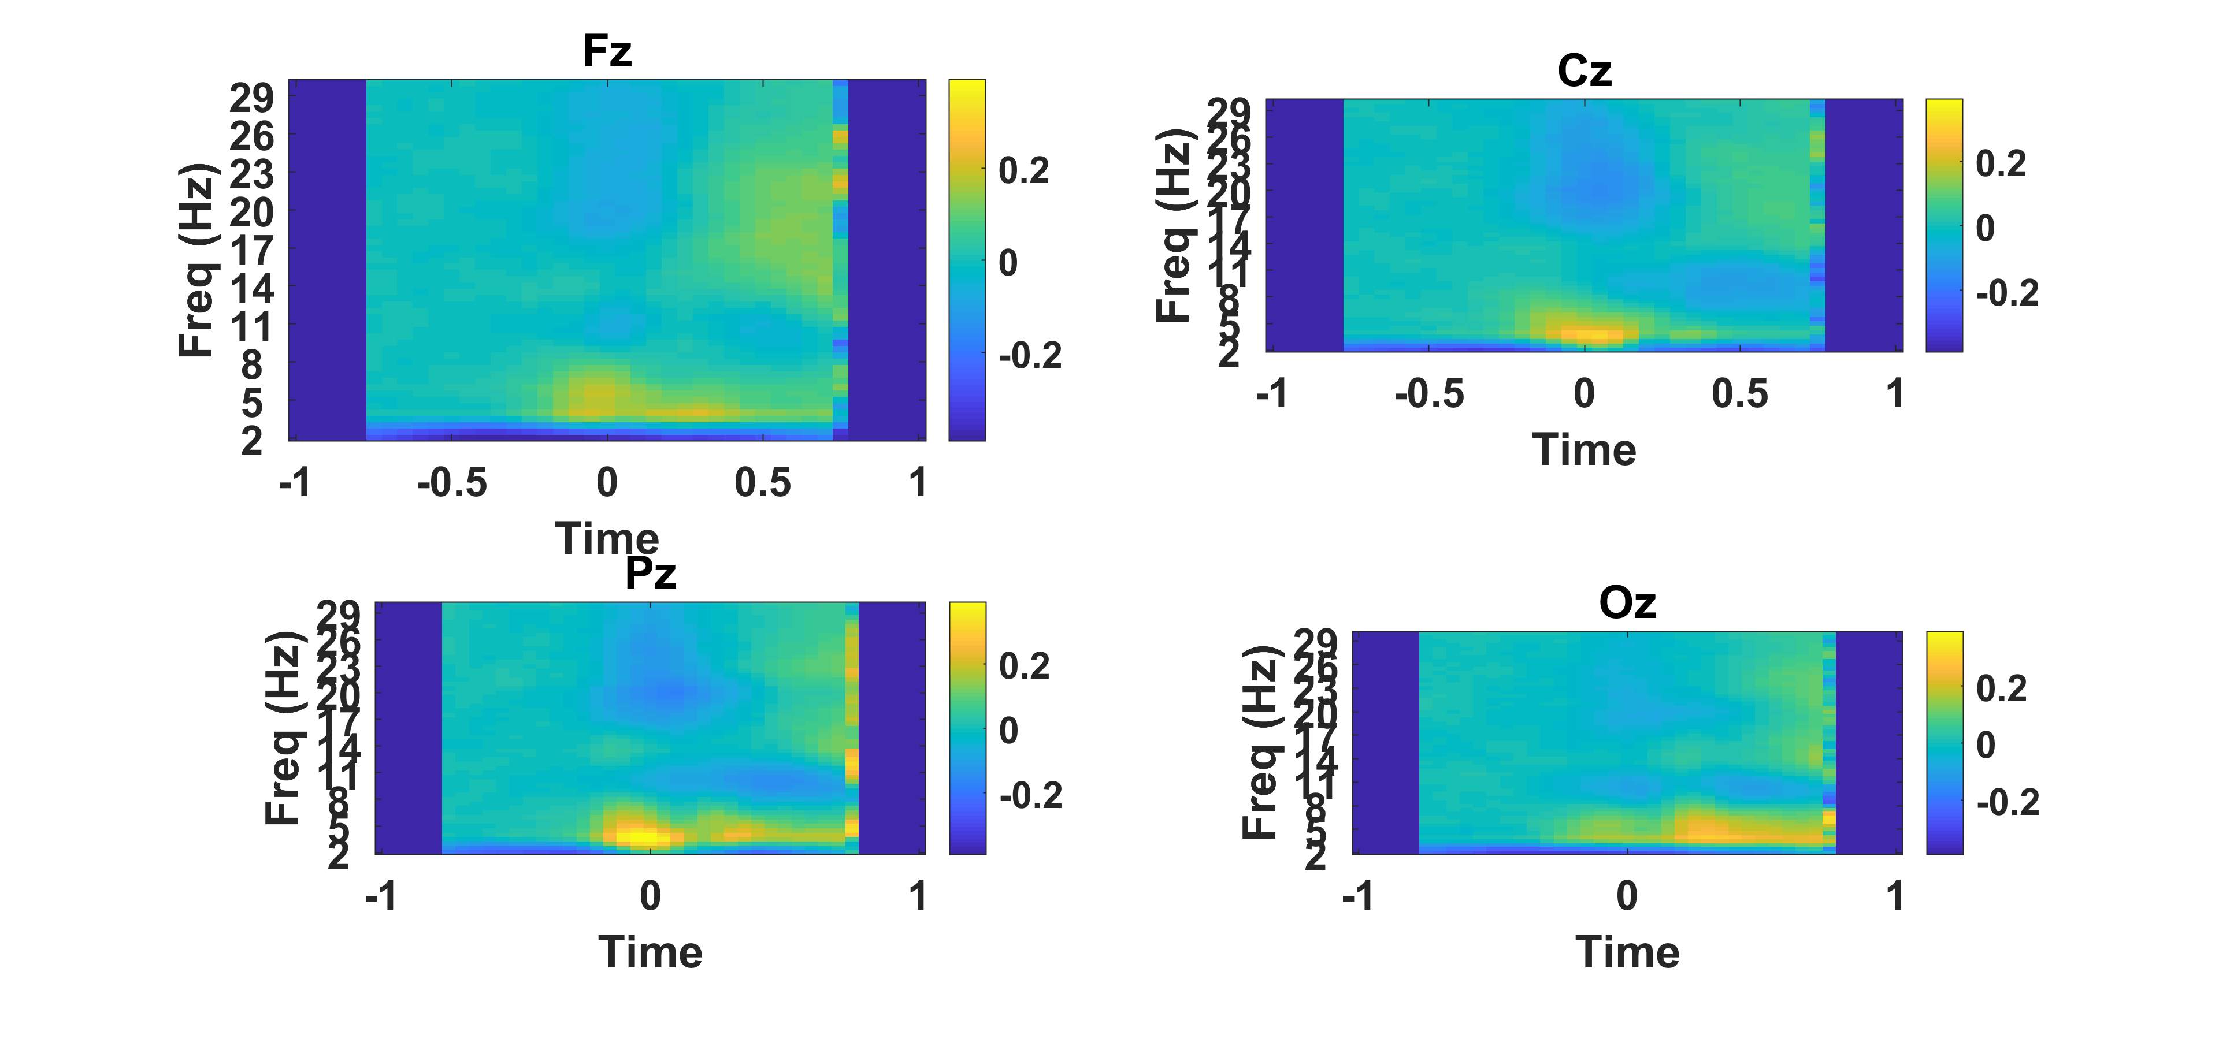
Young 90% Coherence

Slide 23
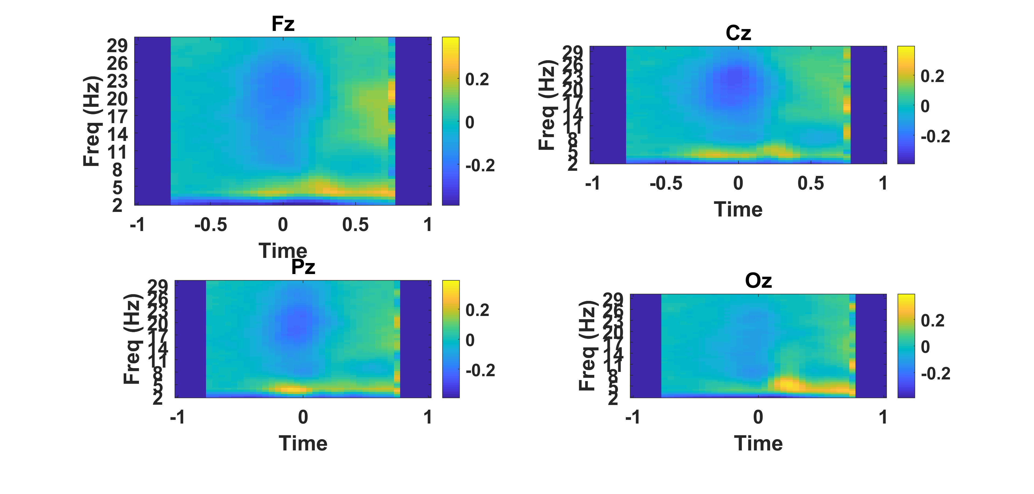
Old 90% Coherence

Slide 24
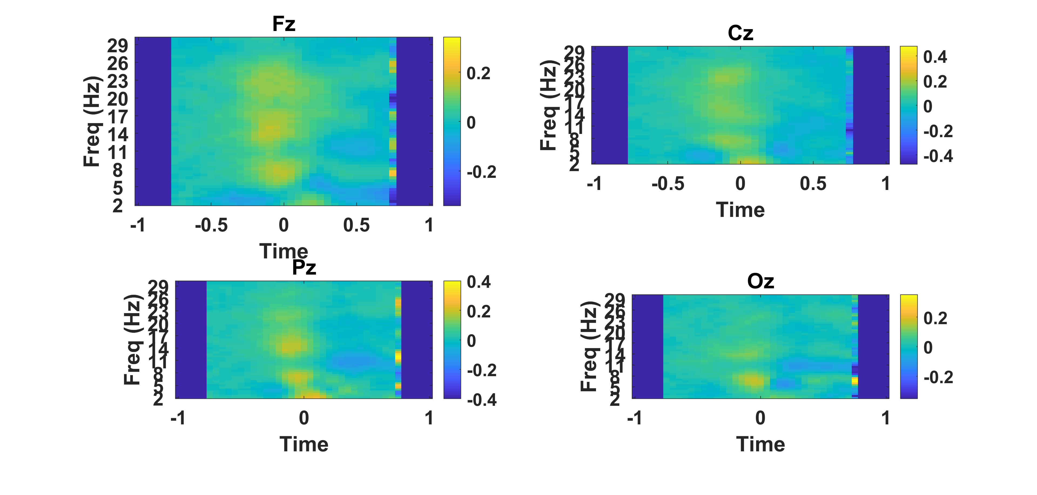
Difference TF – Young-Old

Slide 25

Young 90% Coherence

Slide 26
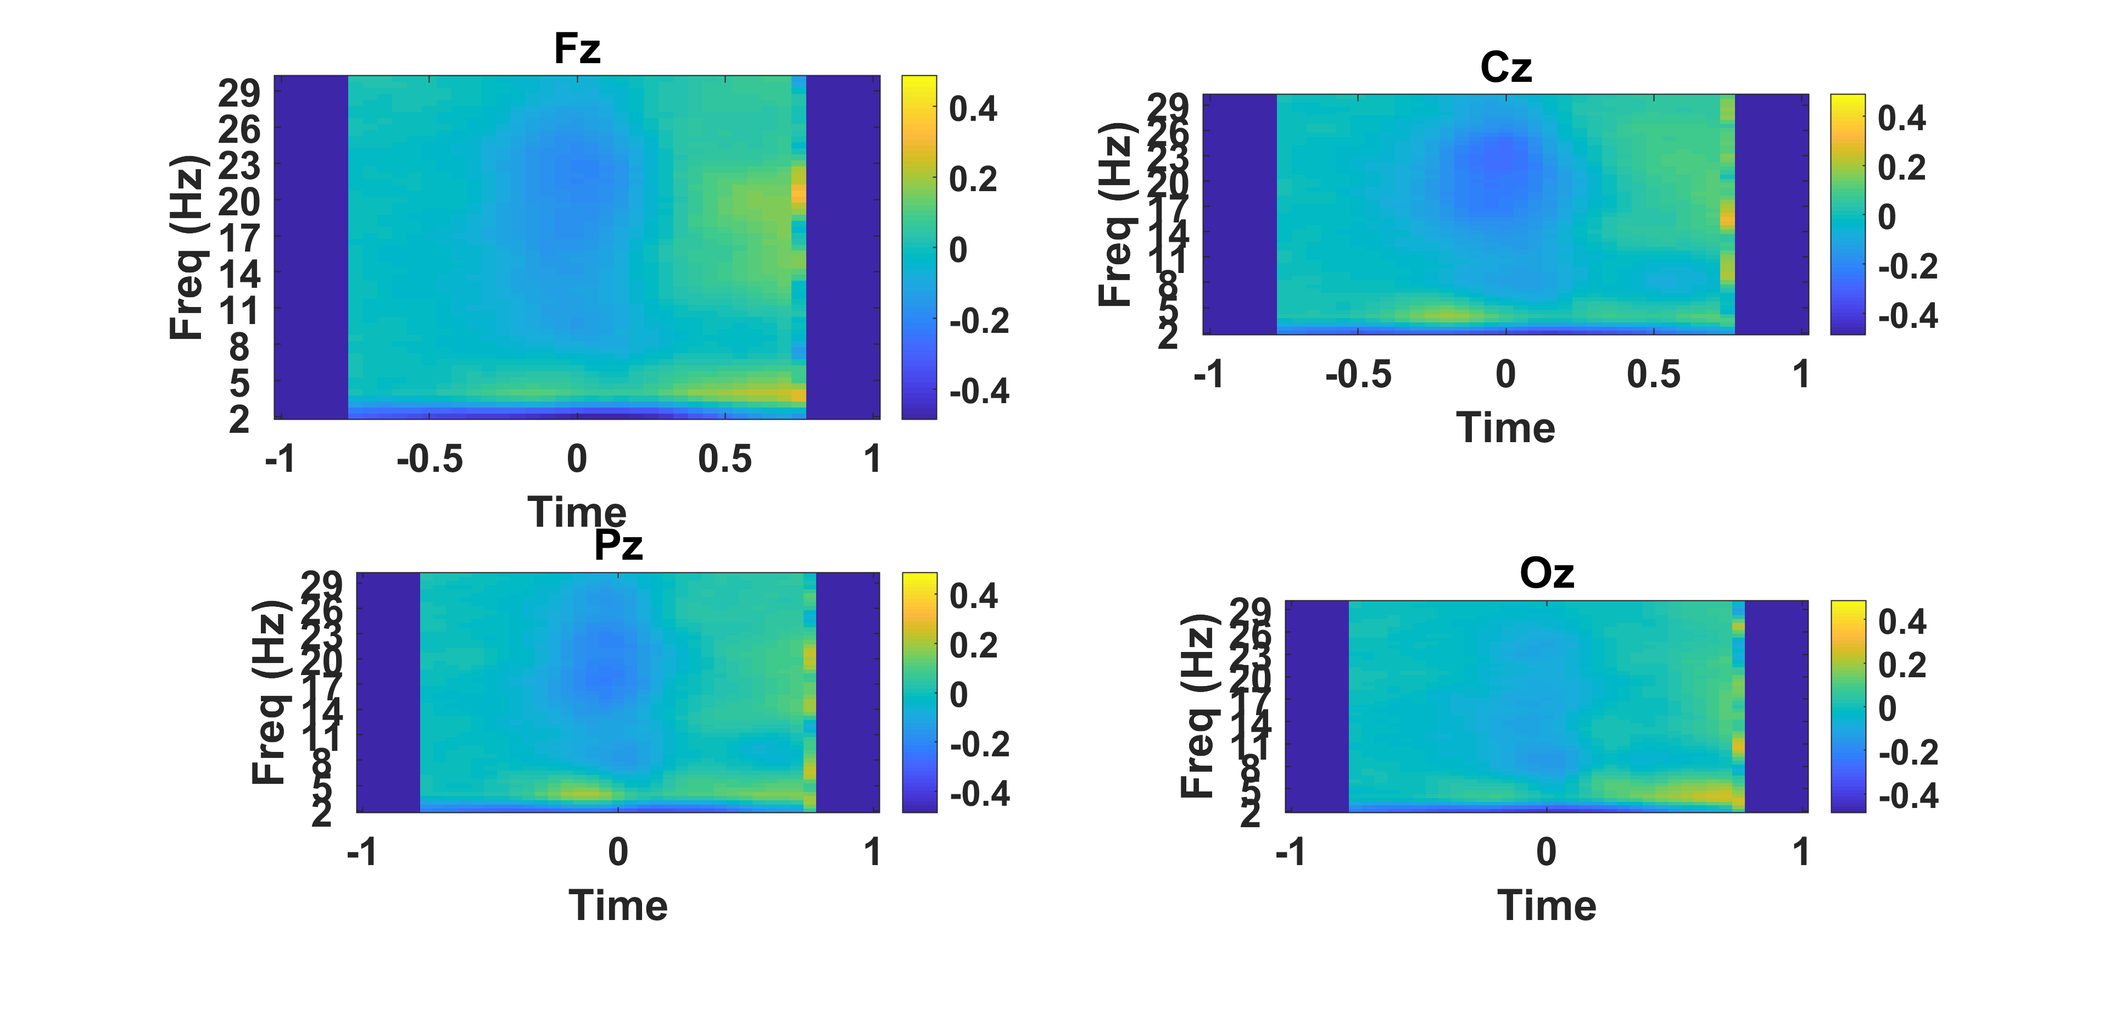
Old 90% Coherence

Slide 27

Difference TF – Young-Old

Slide 28
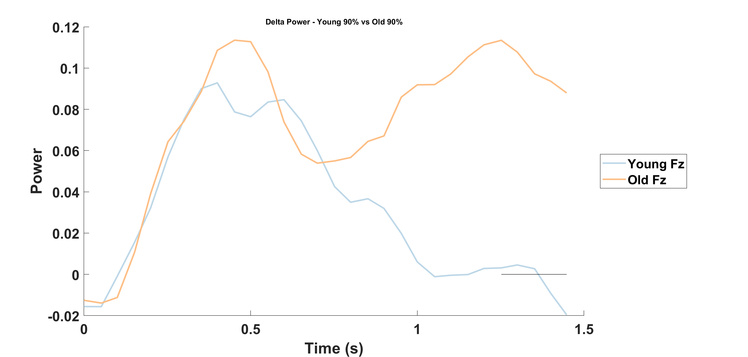
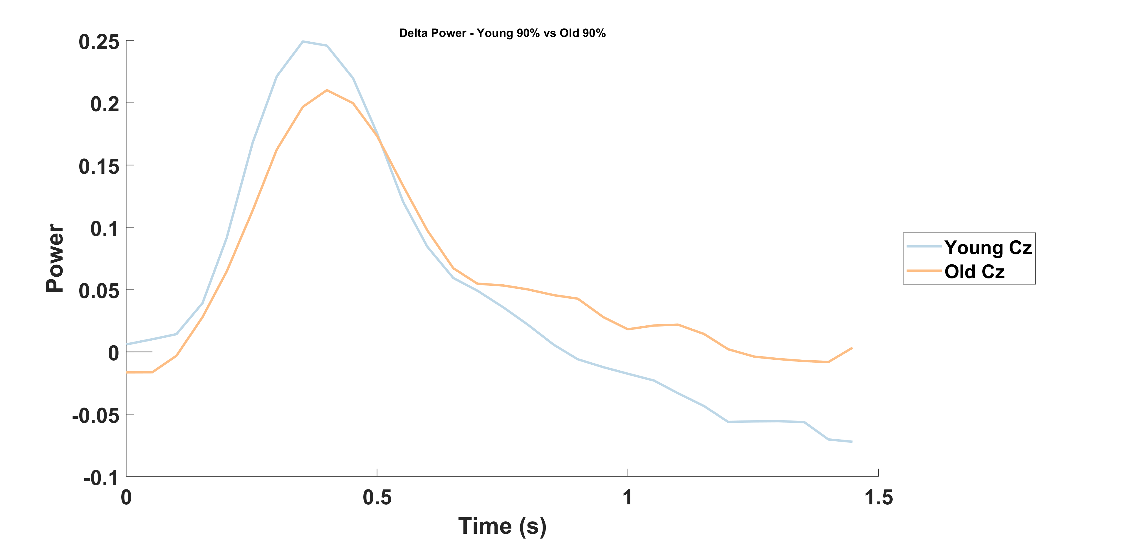
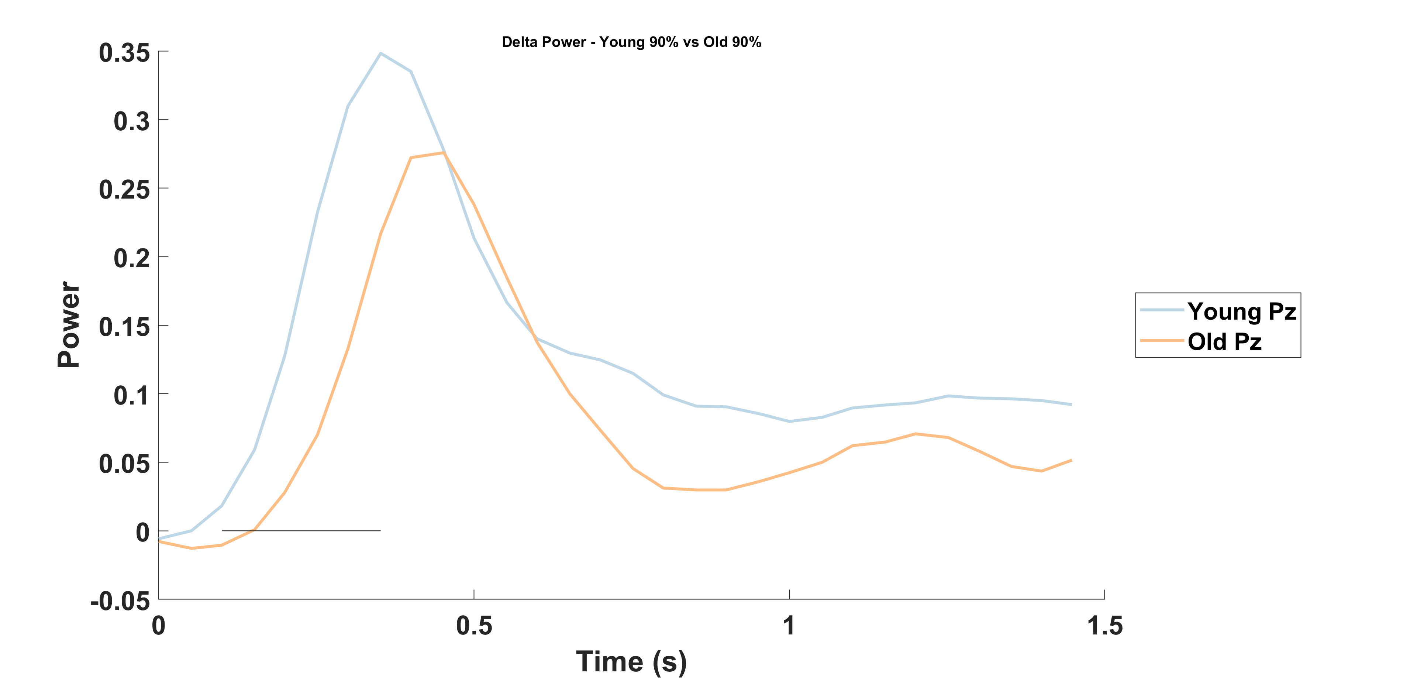
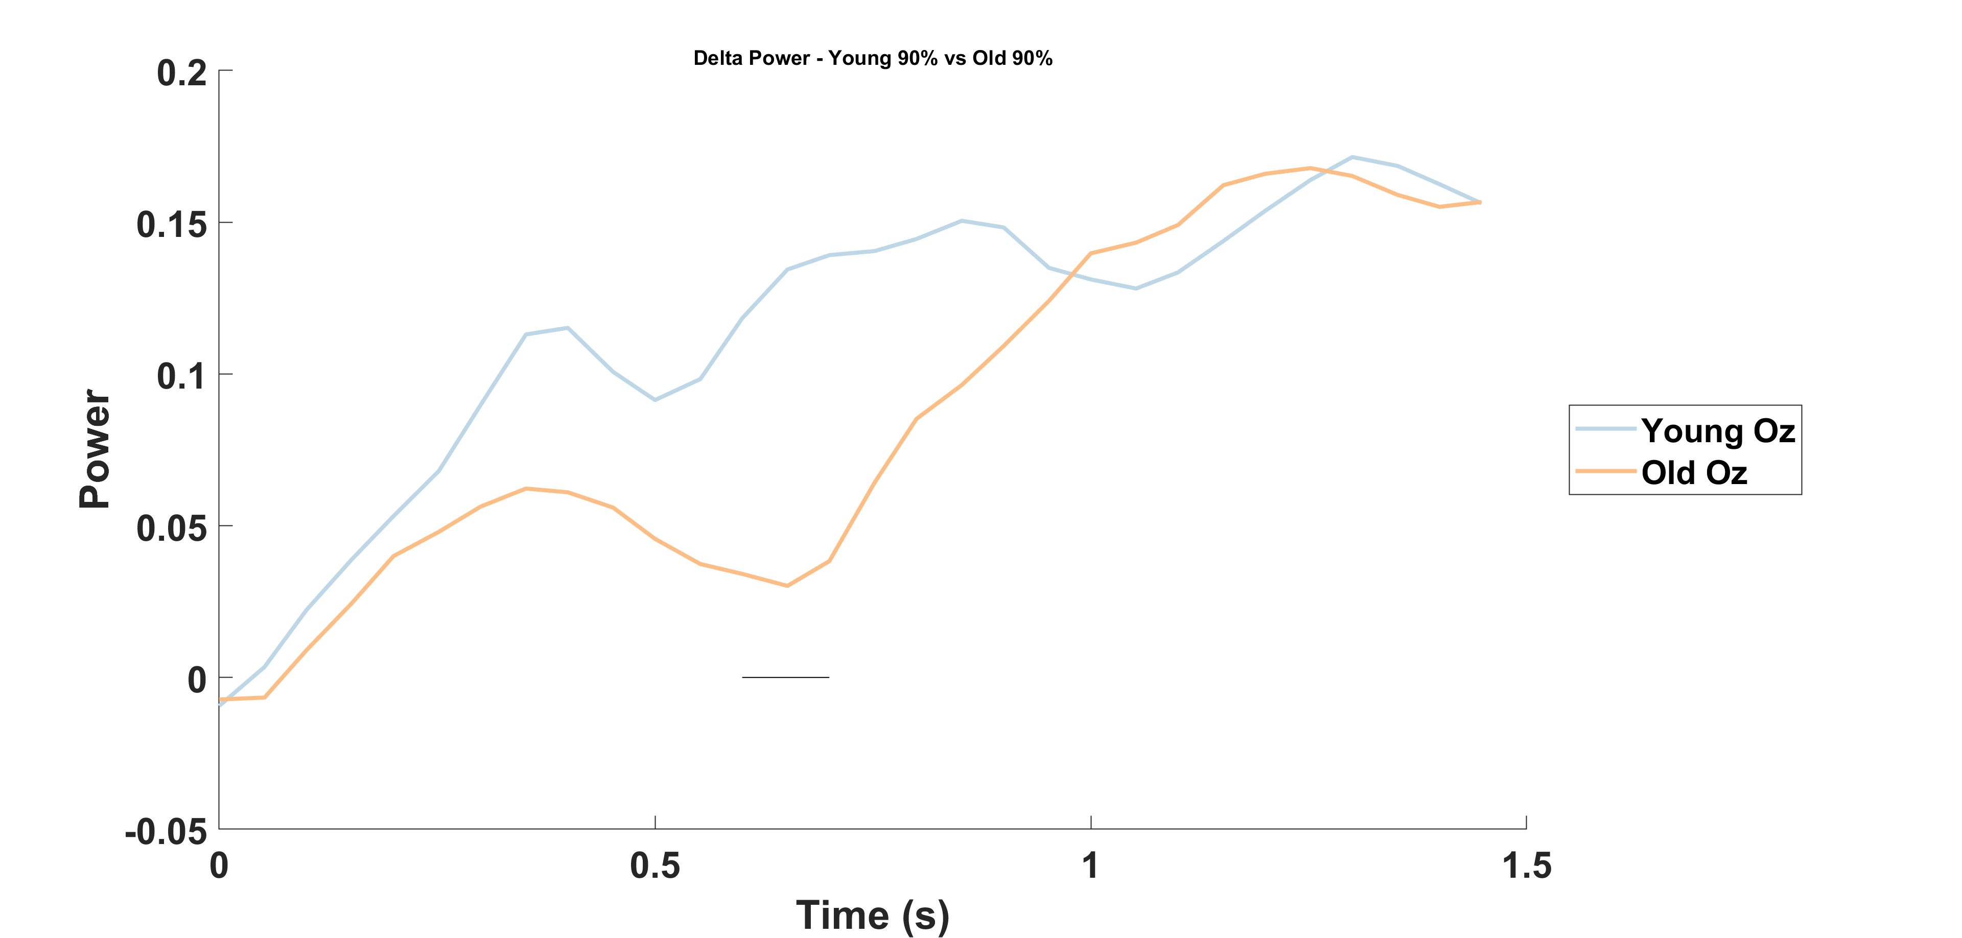

Slide 29
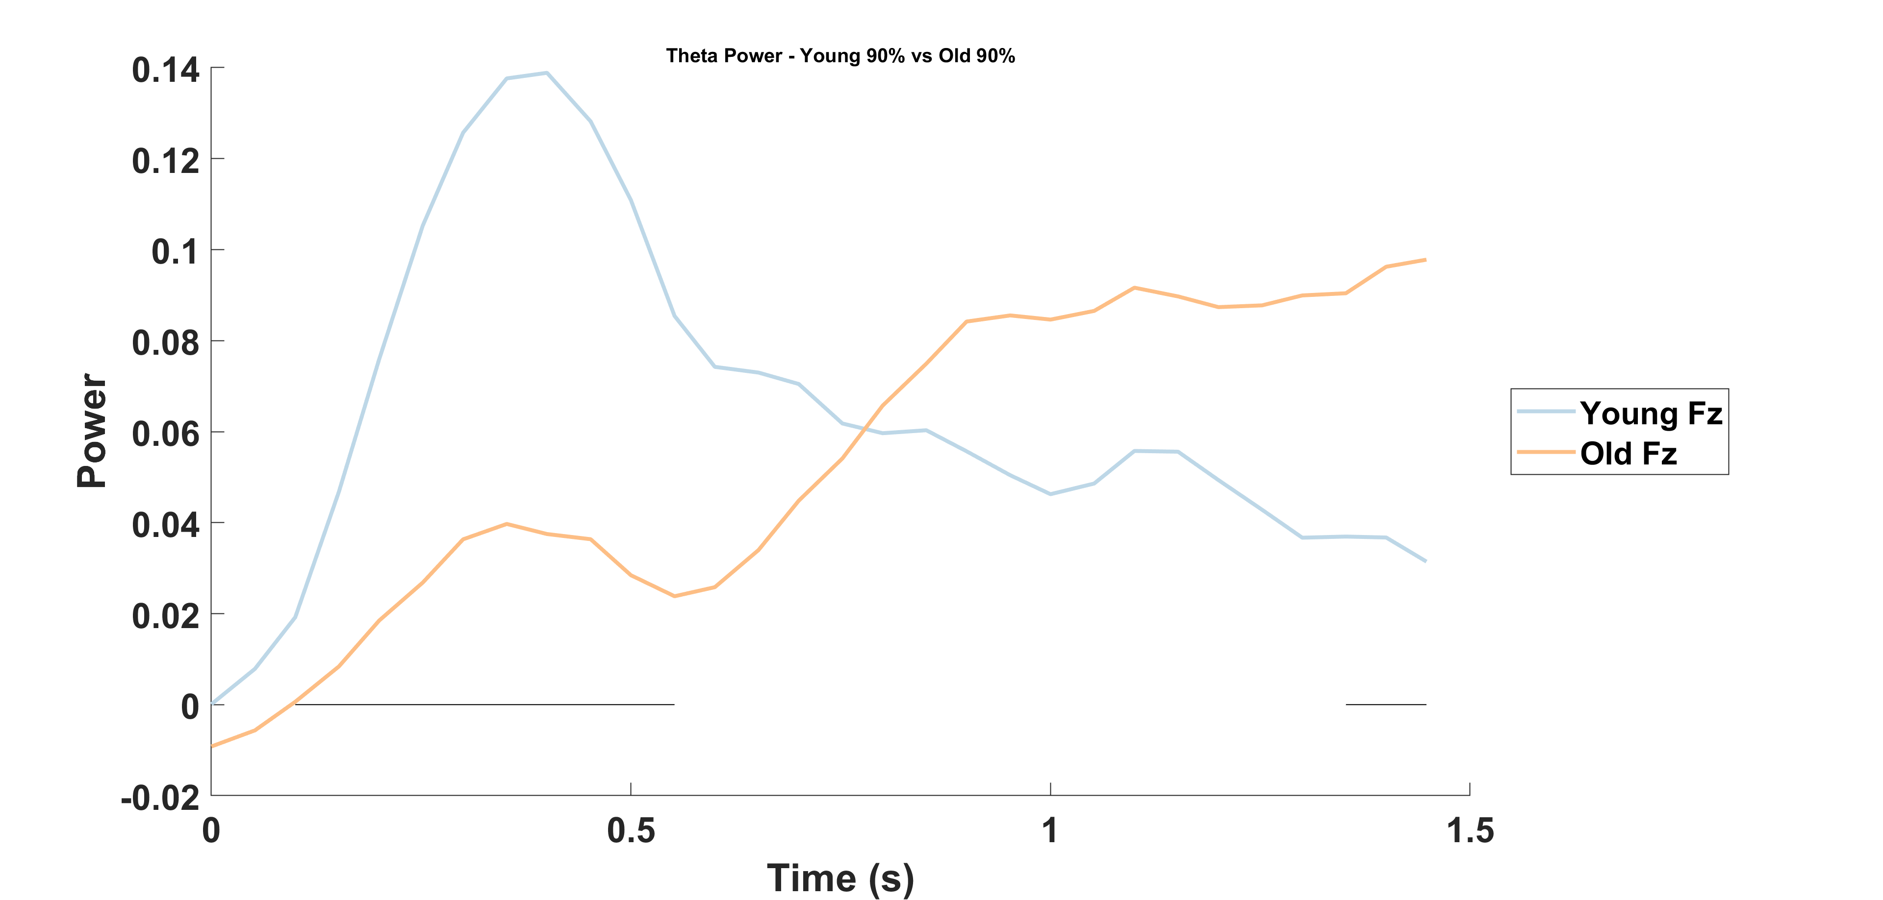
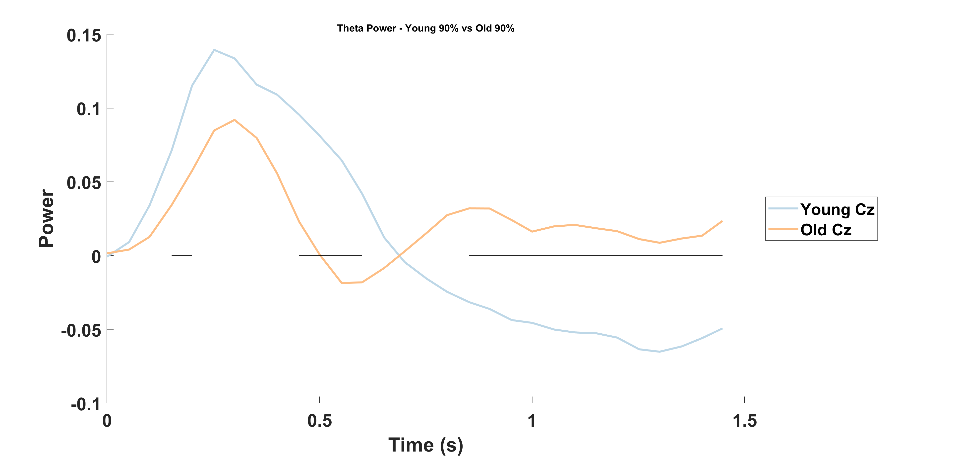
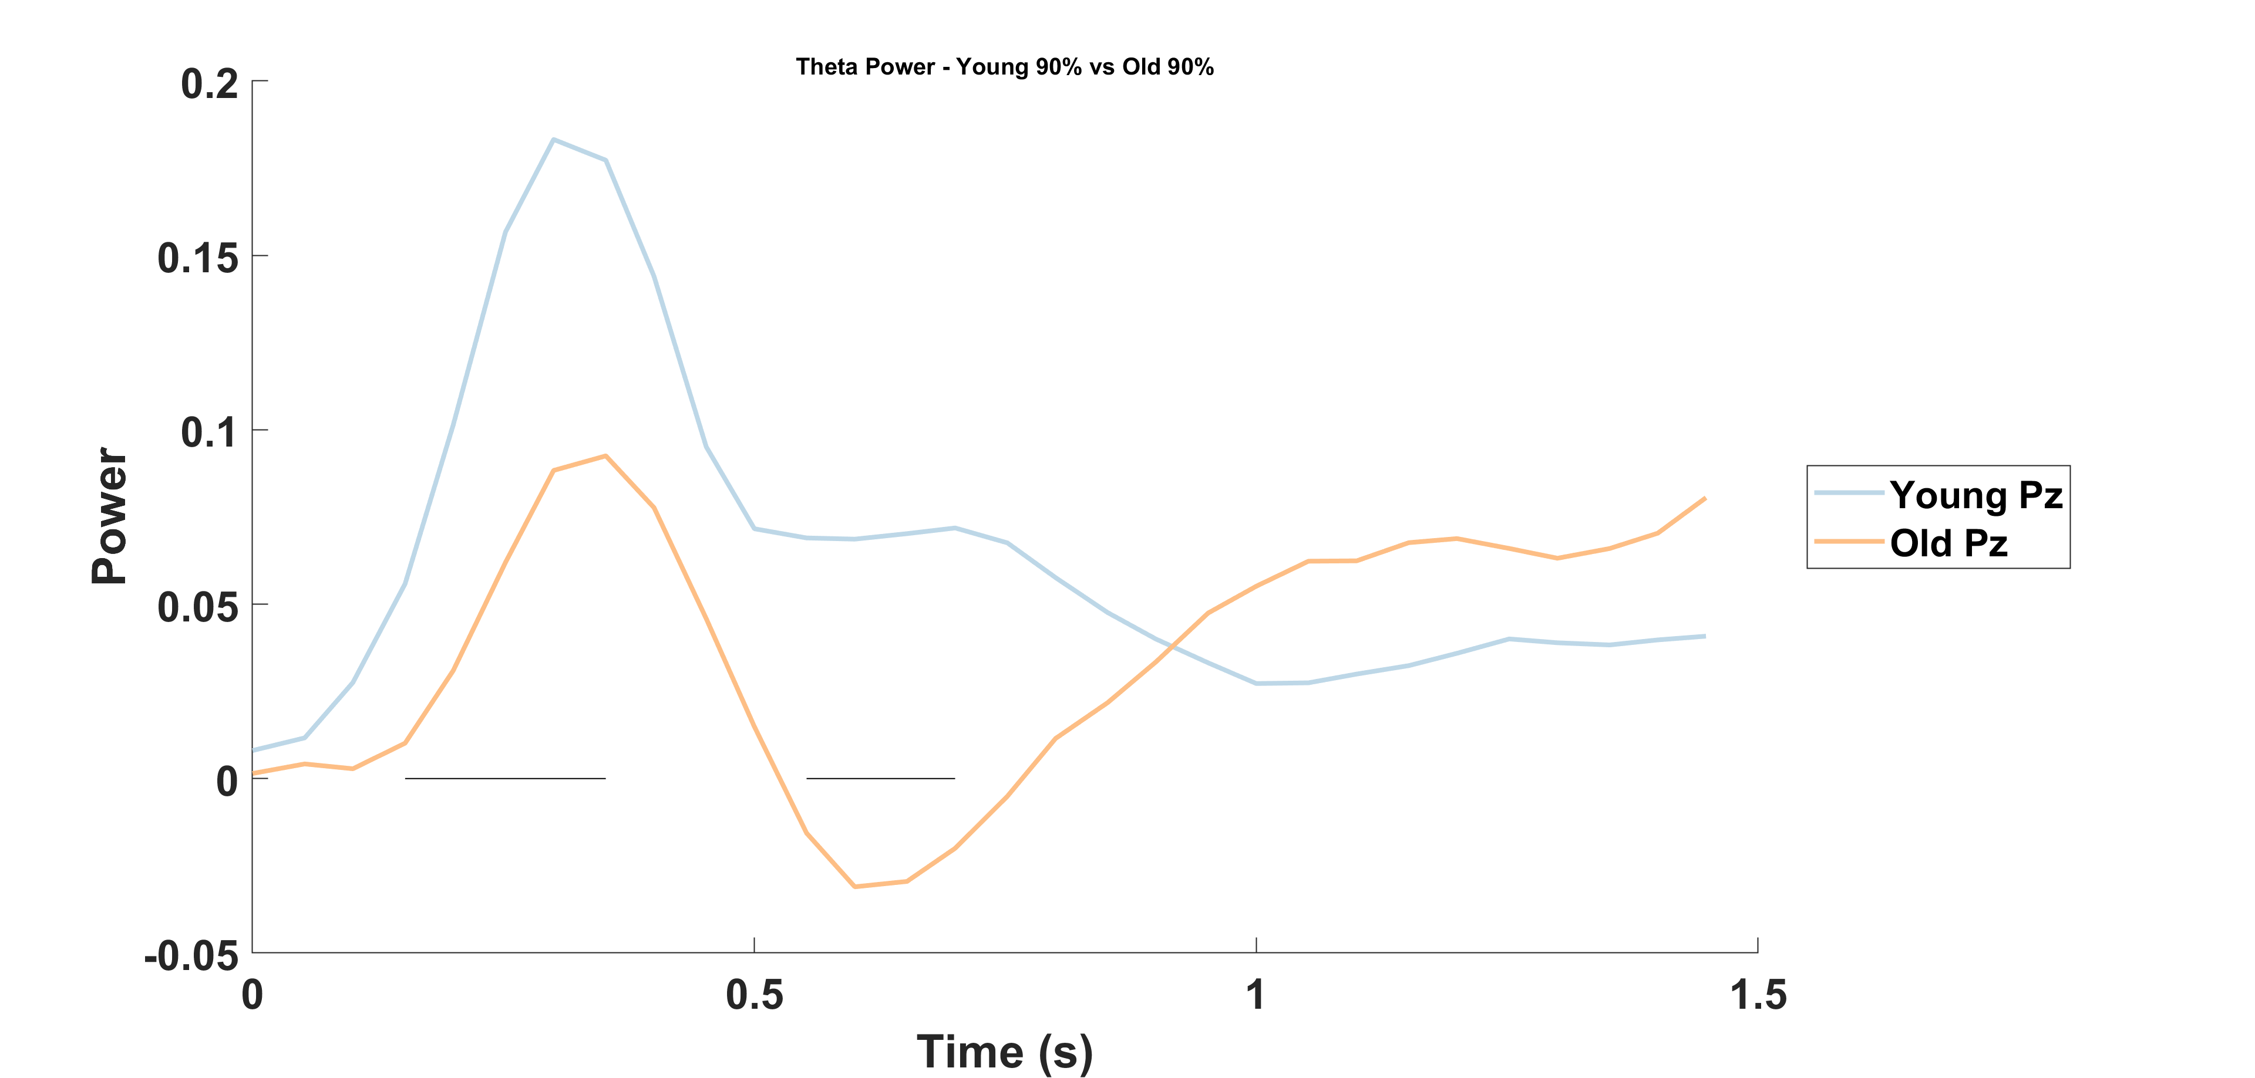
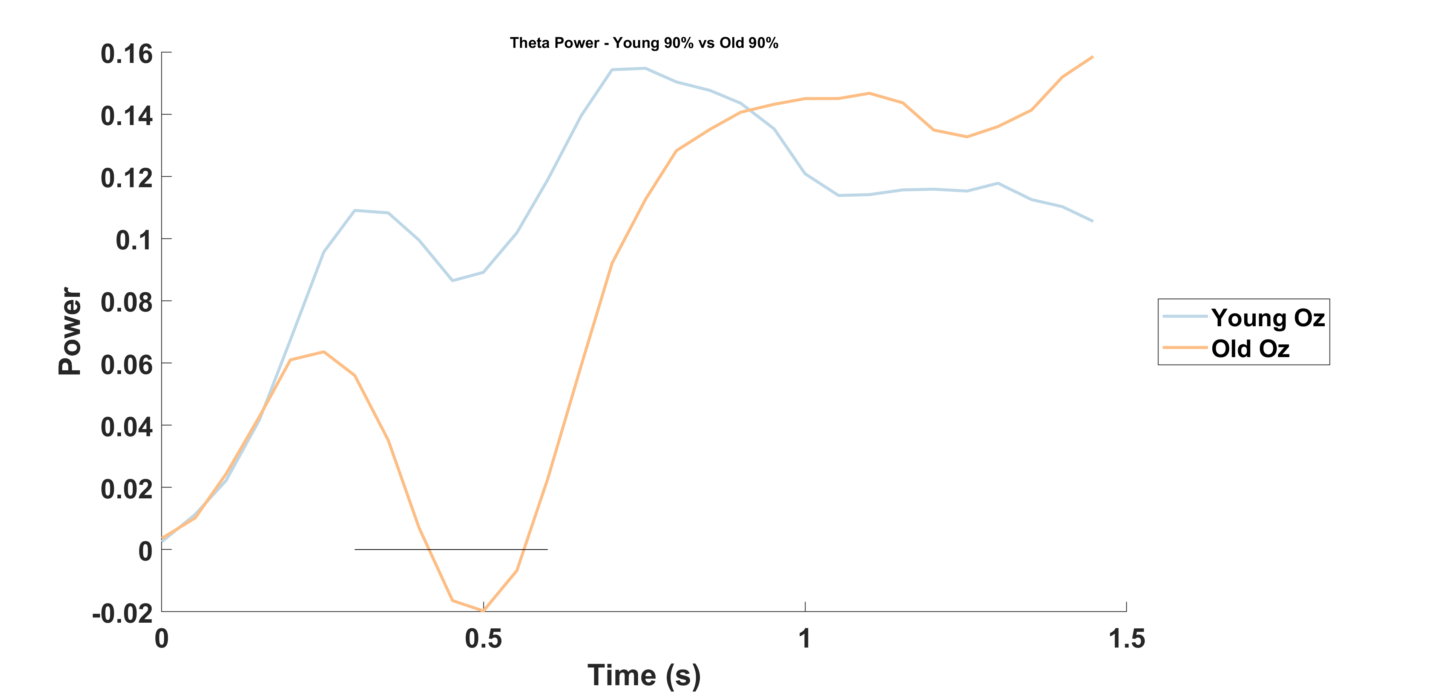

Slide 30
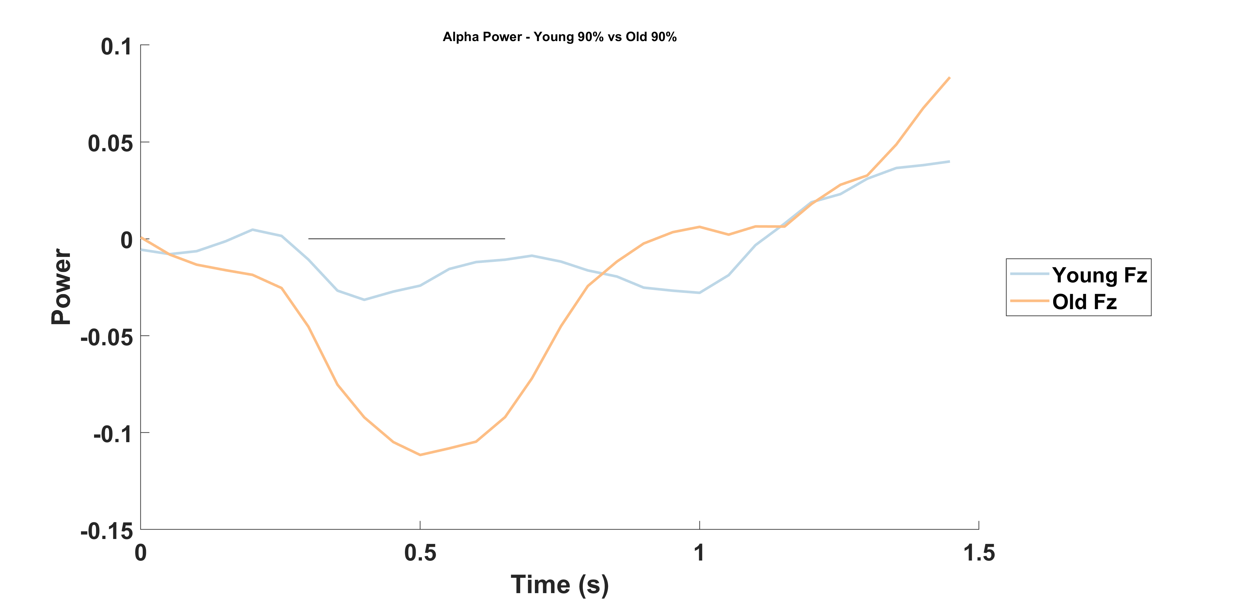
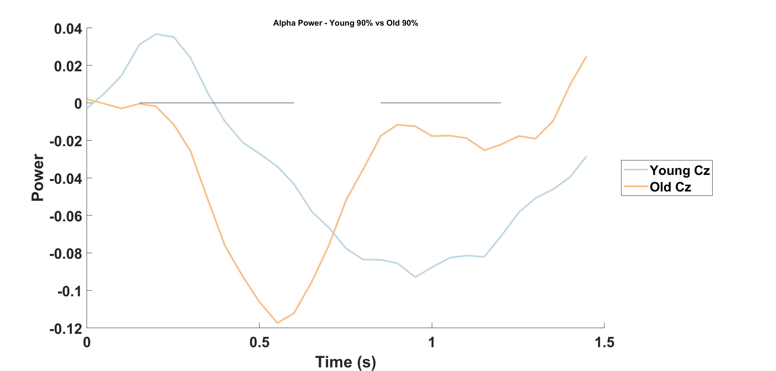
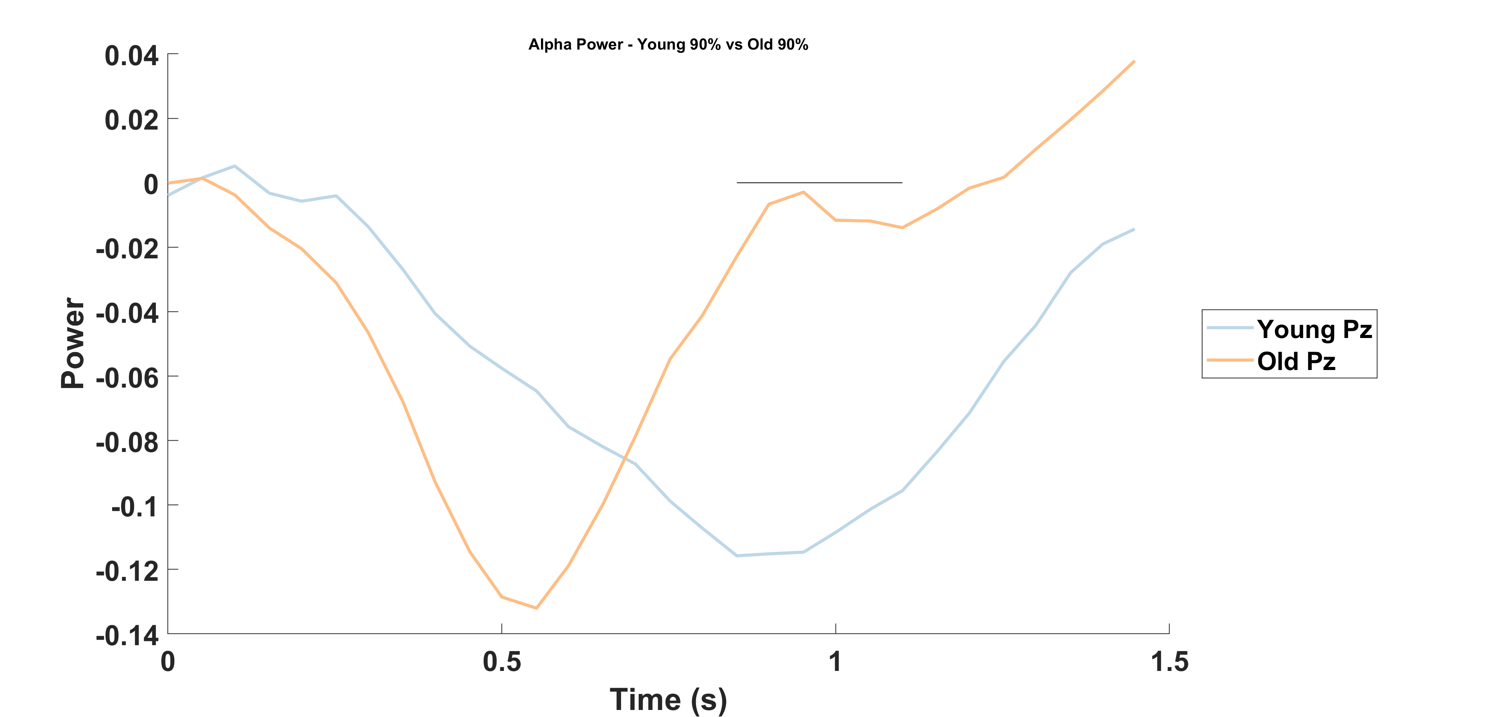
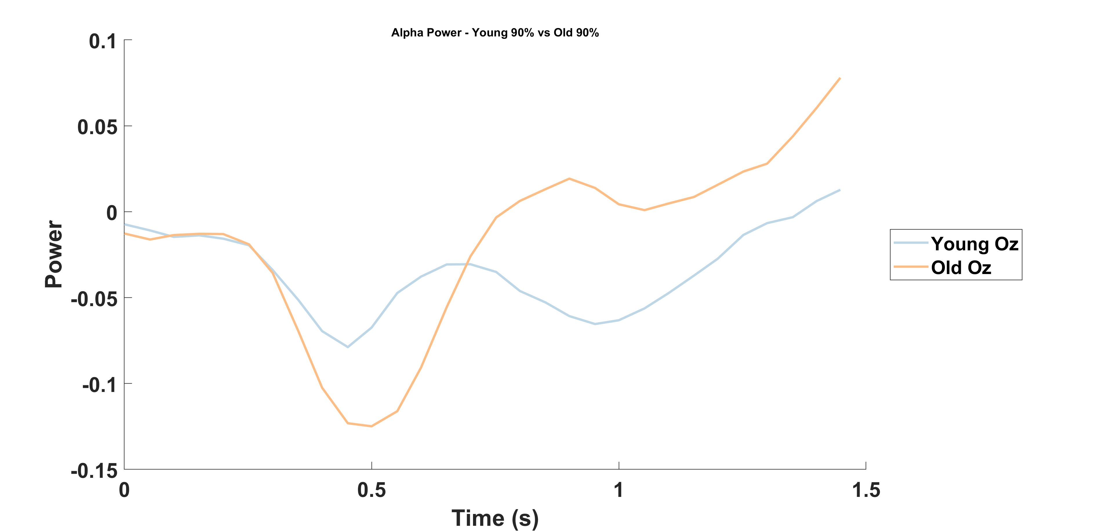

Slide 31
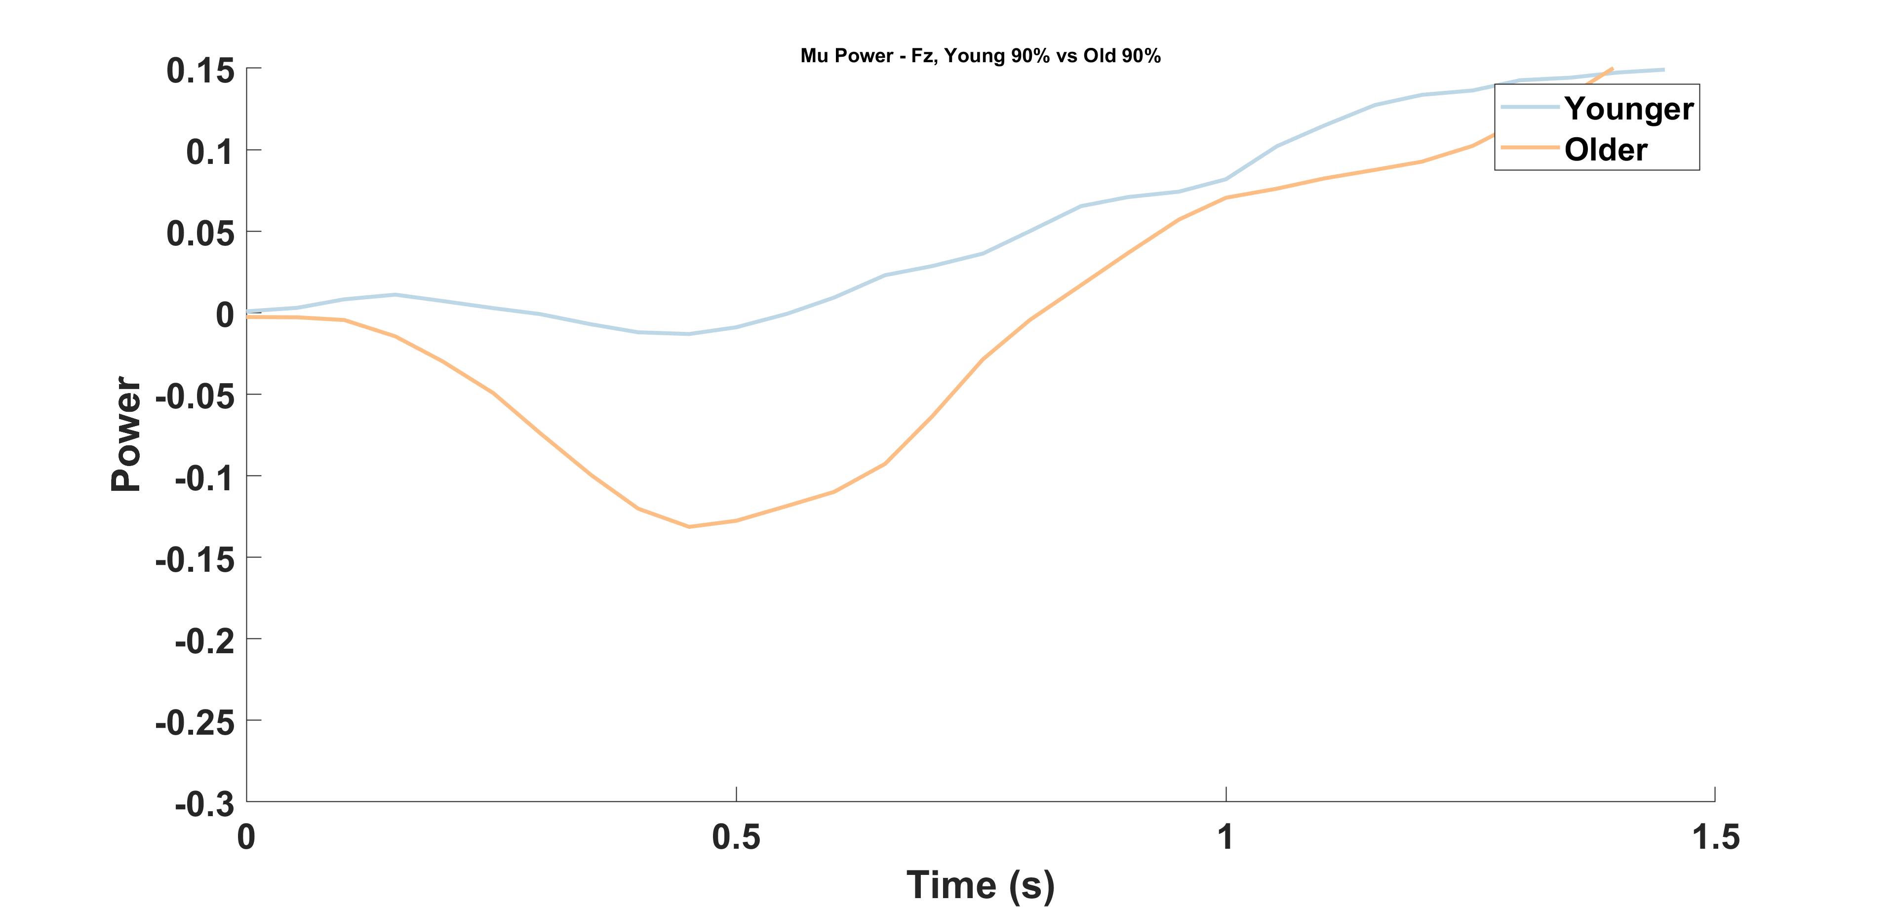
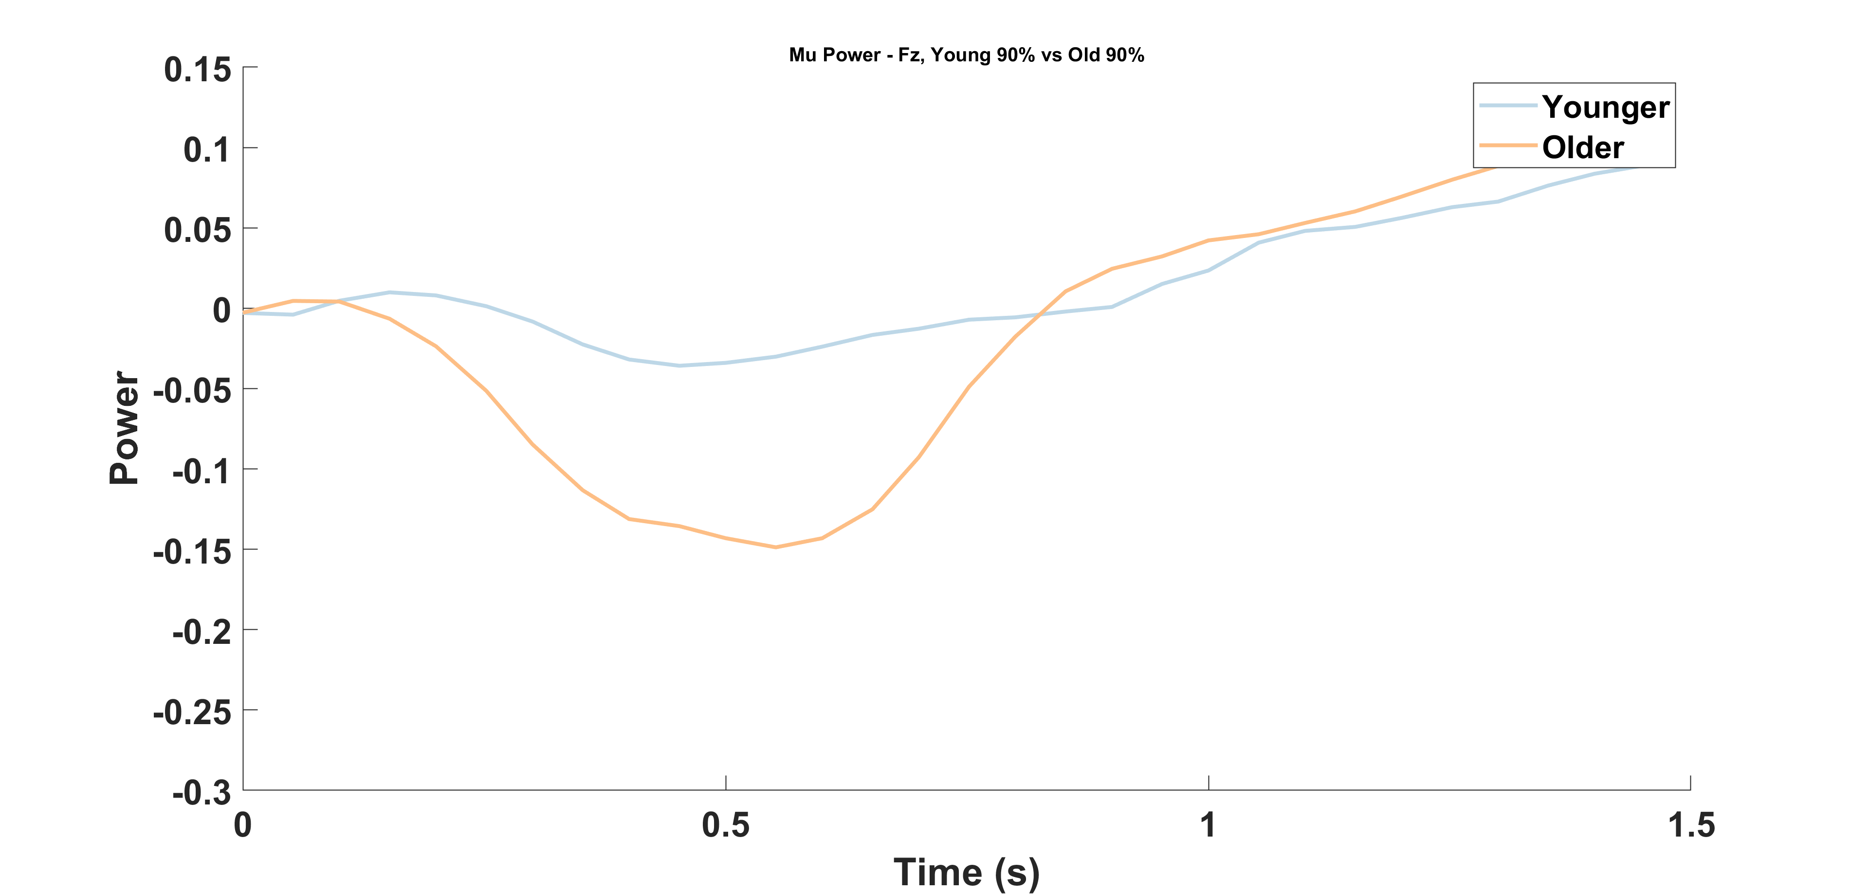
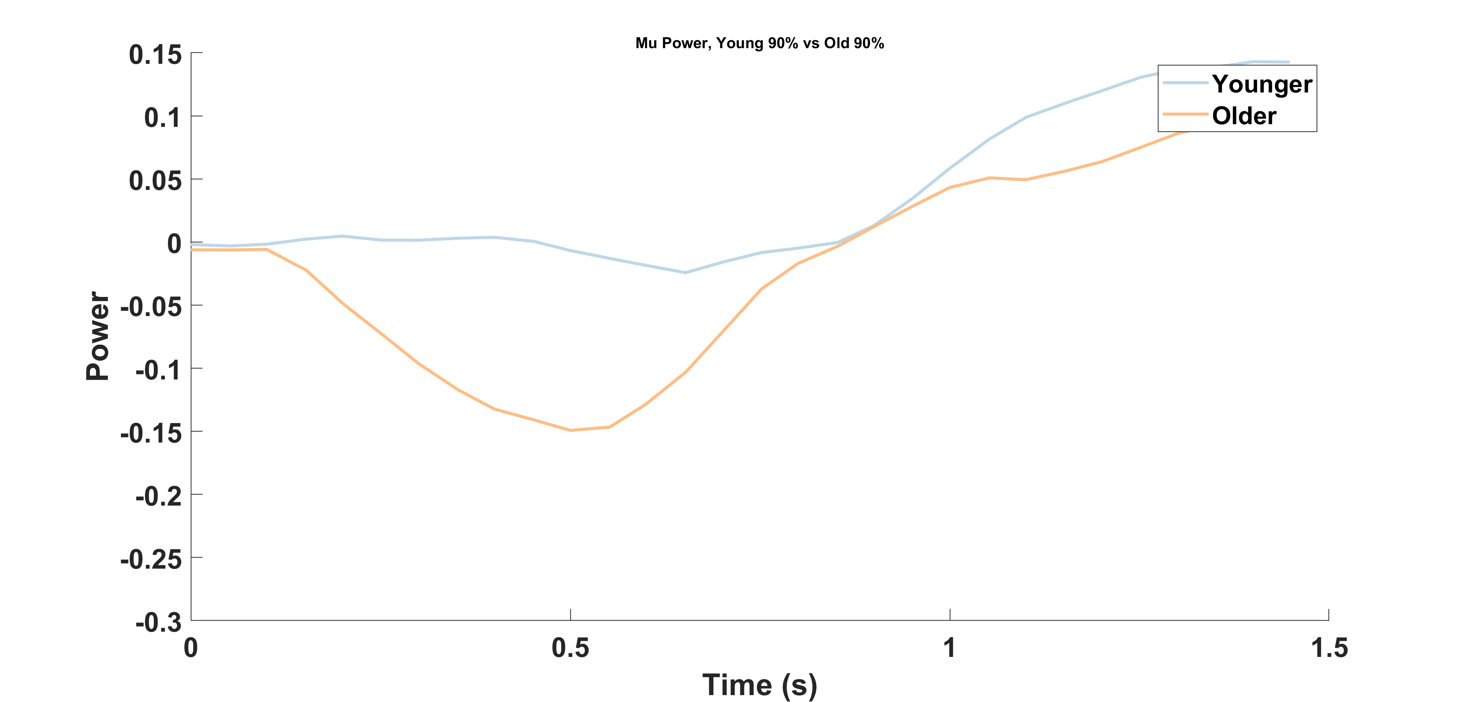
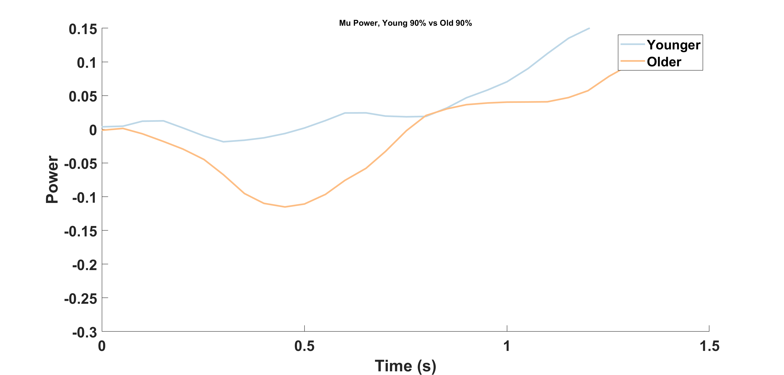

Slide 32
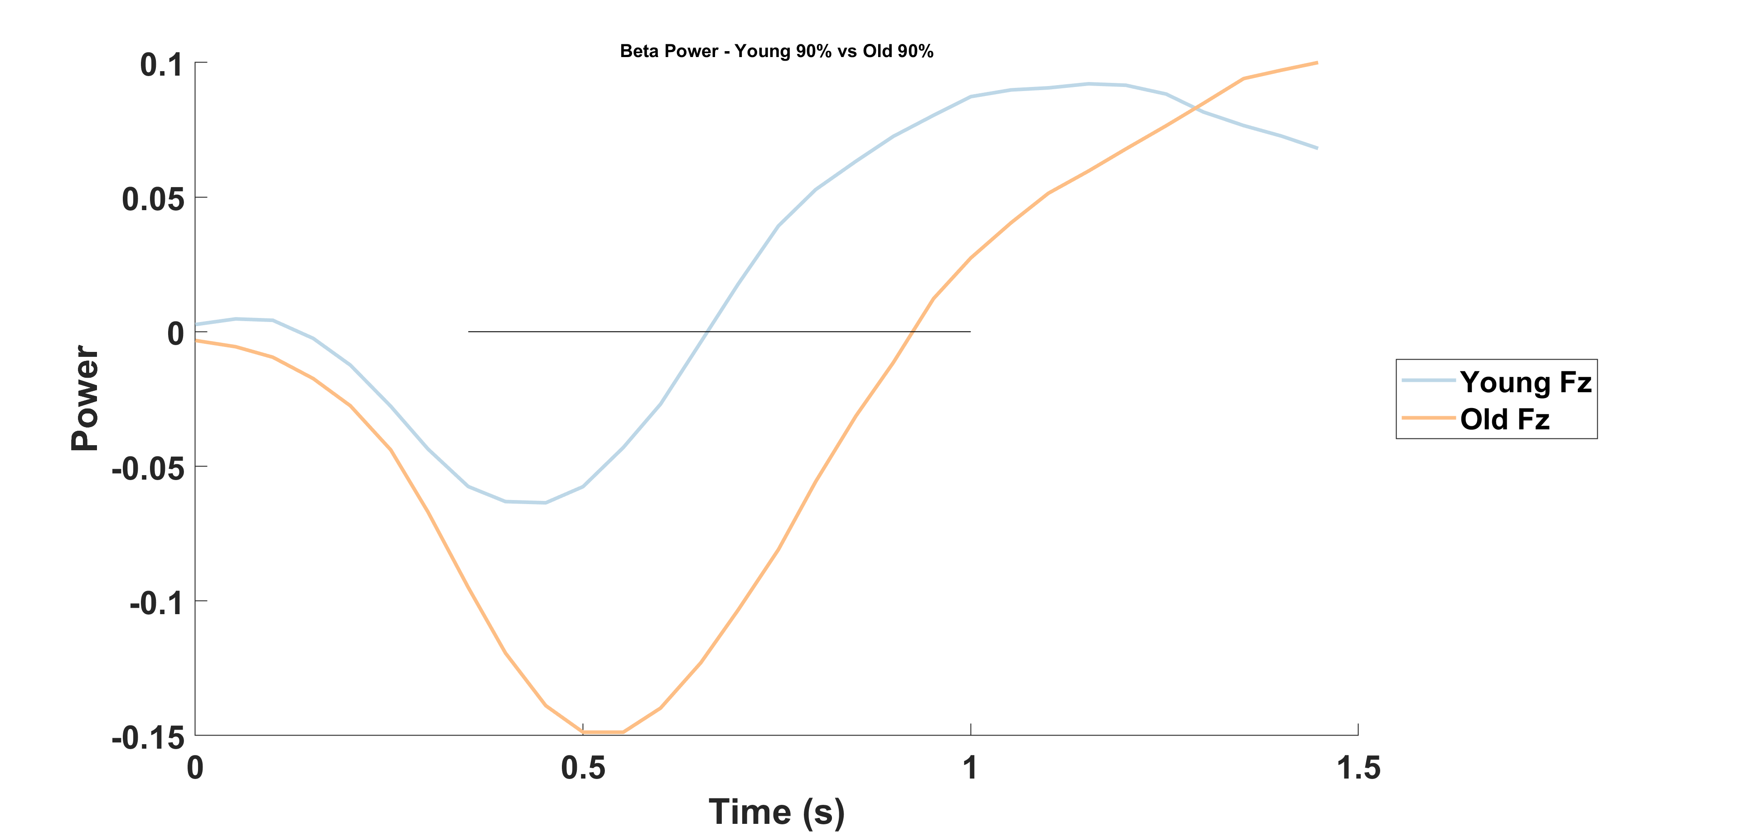




Slide 33





Slide 34





Slide 35





Slide 36




Slide 37





Slide 38





Slide 39





Slide 40





Slide 41





Slide 42





Slide 43





Slide 44





Slide 45





Slide 46





Slide 47





